Slide 1
Neighbor Discovery in a Multi-Transceiver Free-Space-Optical Ad Hoc Network
Jessica Vazquez-Estrada, Suman Bhunia, Mahmudur Khan, Yicheng Qian, Nero Tran

Slide 2
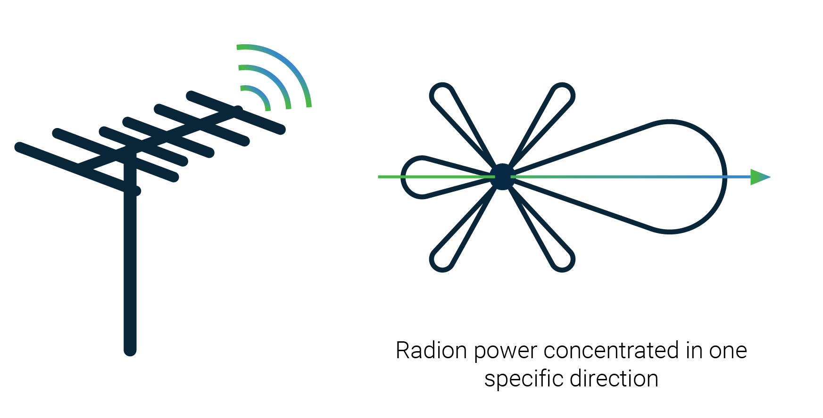
Directional Communication
Demand for high-speed data transfer
Wi-Fi and RF cannot keep up
Direction antennas provide:
High bit rate
High gain
Security
Minimizes packet collision
Spatial reuse enable higher bandwidth
13 April 2022
College of Engineering and Computing
2
Notes:
In the last few decades, the demand for high speed GPS wireless data transfer rates has grown significantly. Traditional radio frequency (RF)-based omnidirectional communication systems such as WiFi or cellular communication cannot achieve such high speed communication. In this context, directional communication such as FSO, millimeter-wave and terahertz communication have demonstrated the potential to help solve the problem of high data rate requirement [1]– [5]. FSO communication (FSOC) has gained an increase in interest due to its high-speed data transfer rate in conjunction with with its low-cost. In addition to high bit rate, FSO transceivers possess high gain properties which allow them to extend to much longer ranges compared to RF transceivers. FSOC networks are a valuable asset in military and secu- rity applications due their invulnerability to electromagnetic and radio frequency interference, making them immutable to active attackers. Furthermore, the high directionality of FSO transceivers minimizes the probability of packet collision and enhances signal security. Moreover, higher spatial reuse can help in establishing multiple parallel communication links with different neighbor nodes and thus enable much larger bandwidth compared to RF.
2

Slide 3
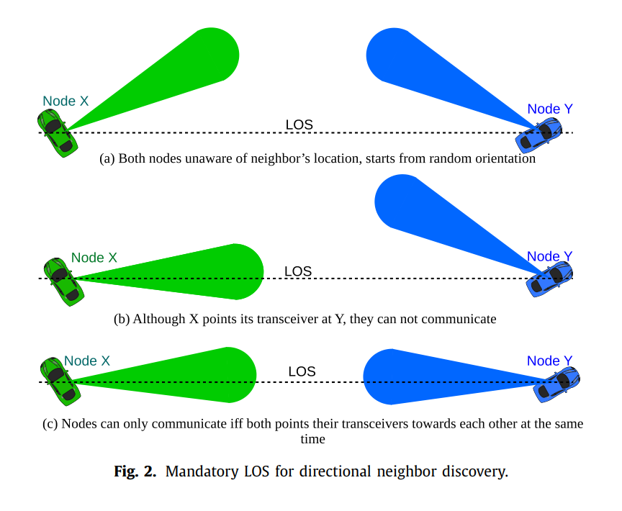
Neighbor Discovery
Directional antennas have limited coverage
Must be in line-of-sight (LOS) to communicate
Oblivious protocols
Do not terminate within a reasonable amount of time.
13 April 2022
College of Engineering and Computing
3

Slide 4
Previous Work
Asynchronous oblivious protocols using ID-based
No prior knowledge of nodes location
Discovery delay is too long
GPS-clock synchronization protocols
GPS works poorly in indoor environments
Poor accuracy
RF-assisted neighbor discovery protocols
Spiral path to cover all nodes and guarantee discovery
Z. Wei, X. Liu, C. Han, and Z. Feng, “Neighbor discovery for unmanned aerial vehicle networks”
Z. Zhang and B. Li, “Neighbor discovery in mobile ad hoc self-configuring networks with directional antennas”
M. Khan, S. Bhunia, M. Yuksel, and L. C. Kane, “Line-of-sight discov-ery in 3D using highly directional transceivers,”
13 April 2022
College of Engineering and Computing
4
Notes:
Protocols in which the nodes are oblivious to one another, meaning they have no prior knowledge of each other’s location, have been explored but do not terminate in a reasonable amount of time
4

Slide 5
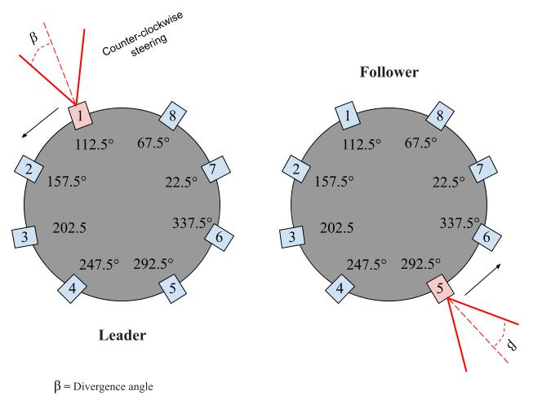
Model Assumptions
Nodes: each node exists in a 2D ad hoc network
Directional transceivers
Electronic beam steering: Activating a specific transceiver at a specific time, determines the direction of transmission/reception
Omni-assisted channel: LoRa is used to synchronize the LOS discovery
Compass
13 April 2022
College of Engineering and Computing
5
Notes:
5

Slide 6
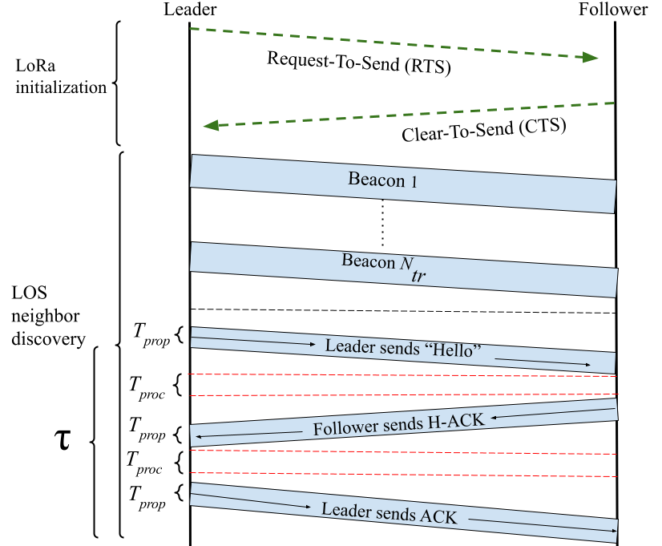
Omi-assisted Neighbor Discovery
Omni-assisted channel
Long Range omnidirectional channel(LoRa)
Can communicate with very low SNR
Discovery method guarantees neighbor discovery within one 360° beam sweep.
13 April 2022
College of Engineering and Computing
6
Notes:
6

Slide 7
Discovering a Single Neighbor
Number of transceivers
Transceiver angle
$$N_{tr}=⌈\frac{360}{2β}⌉$$
$$θ_{i}=\frac{i×360}{N_{tr}}+β$$
13 April 2022
College of Engineering and Computing
7
Notes:
Fixed nodes
7

Slide 8
Omi-assisted Neighbor Discovery
13 April 2022
College of Engineering and Computing
8
Notes:
8

Slide 9
Discovering a Multiple Neighbors Simultaneously
Iterative, ID-based approach
Leader: initiates communication
Leader election:
Leader discovers all neighbors in one scan
Follower with lowest ID is the new leader
Ends when all nodes discover all their neighbors
13 April 2022
College of Engineering and Computing
9

Slide 10
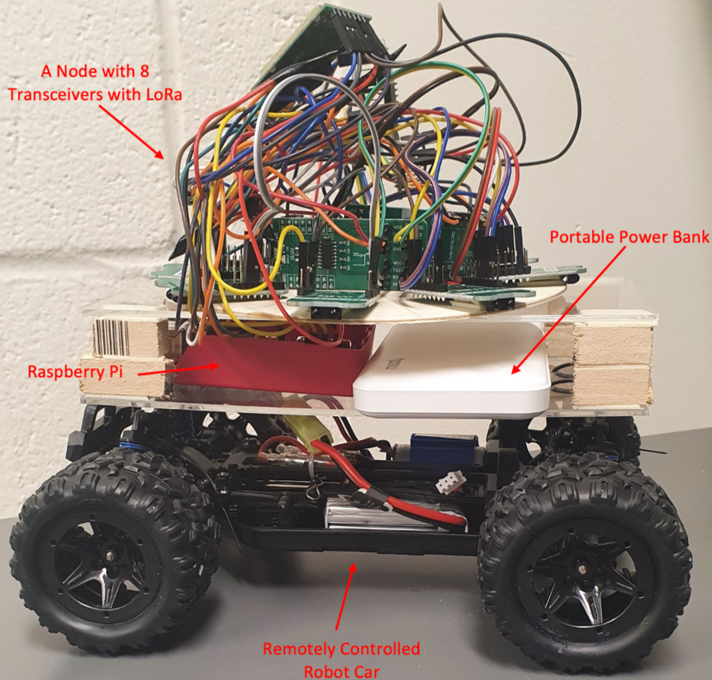
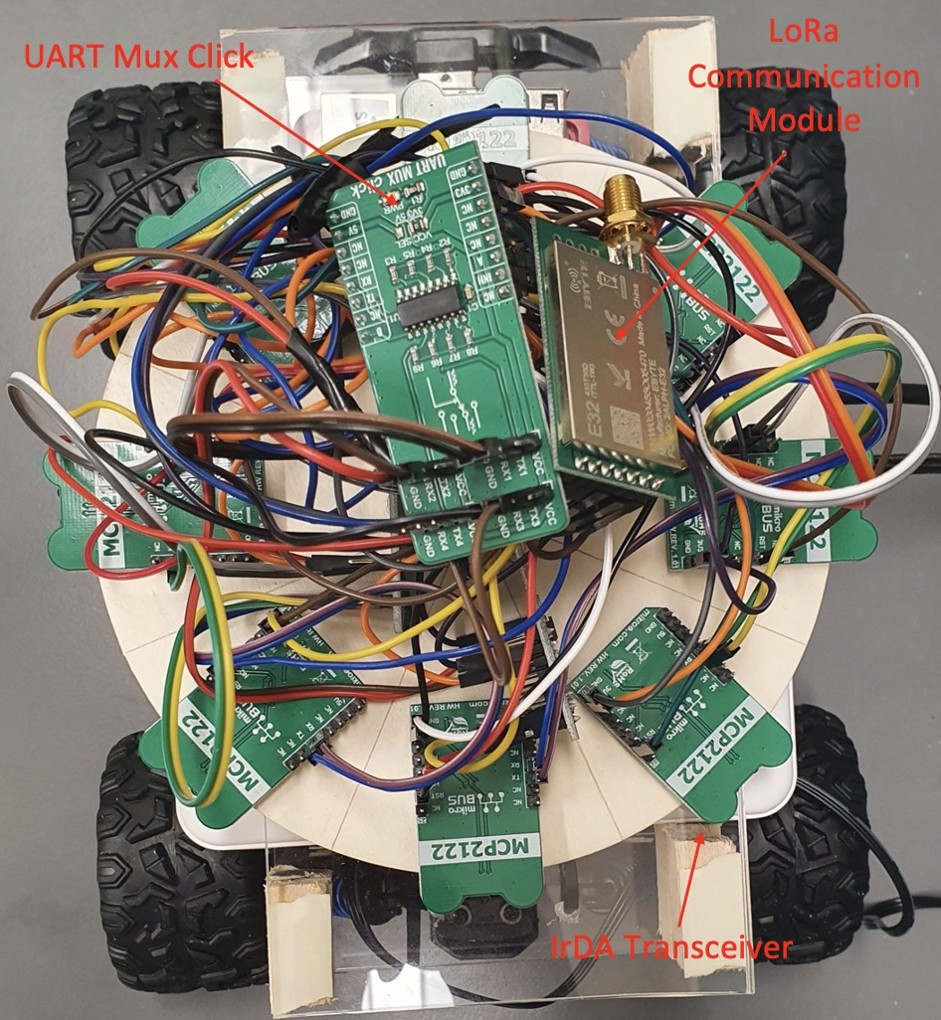
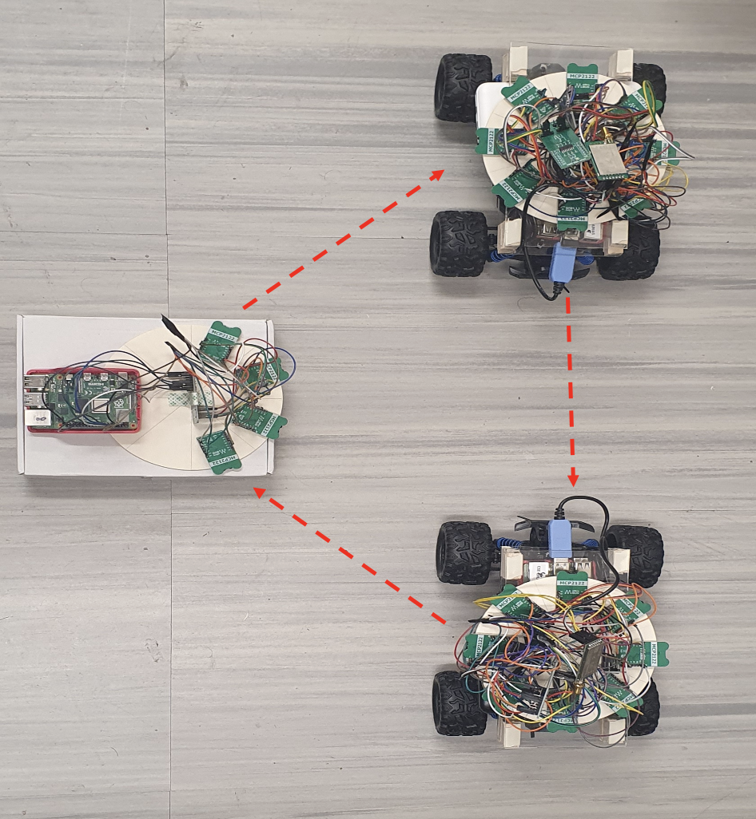
Proof-of-Concept
System Prototype
13 April 2022
College of Engineering and Computing
10

Slide 11
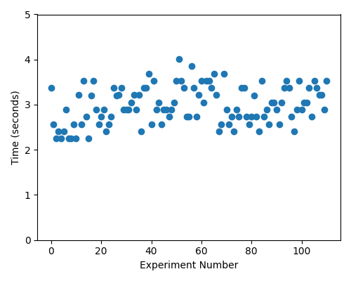
System Results
UART-based serial communication for sending packets through IRDA
Coded using Python
110 experiments
Sleep time: 160 milliseconds
Results in increase of 𝜏
Average time: 2.985 seconds
13 April 2022
College of Engineering and Computing
11
Notes:
Add simulation details (how many nodes,
11

Slide 12
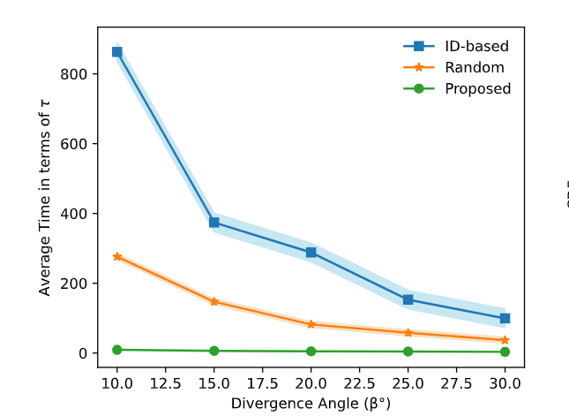
Simulation Results
Single neighbor
When compared to the random-based:
Discovery in benchmark not guaranteed
β = 10°: 98.19% time reduction
β = 30°: 95.68% time reduction
When compared to the ID-based:
Discovery in benchmark guaranteed
β = 10°: 99.42% time reduction
β = 30°: 98.38% time reduction
13 April 2022
College of Engineering and Computing
12
Notes:
12

Slide 13
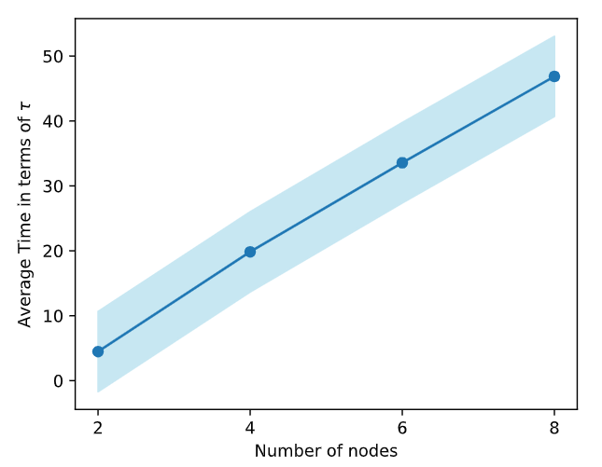
Neighbor Discovery Simulation
Using Python
Thousands of trials to consider varying:
Node location
Beam width
Single-node neighbor discovery
Multiple-node neighbor discovery
2-8 nodes in the network
13 April 2022
College of Engineering and Computing
13
Notes:
13

Slide 14
Conclusion
Using a very low data rate omnidirectional communication enables guaranteed quick discovery.
We prove that the proposed protocol can achieve guaranteed neighbor discovery in a shorter time.
Next steps:
Handle packet-collision
Standard network simulators
3D model
13 April 2022
College of Engineering and Computing
14
Notes:
14

Slide 15
Thank You for
Your Attention!

