Slide 1
Electronically Steerable Mobile Optical-Wireless Mesh-Network
Suman Bhunia, Yicheng Qian, and Mahmudur Khan Department of Computer Science and Software Engineering, Miami University, Oxford, Ohio, USA Department of Electrical & Computer Engineering and Computer Science, York College of Pennsylvania, USA

Slide 2
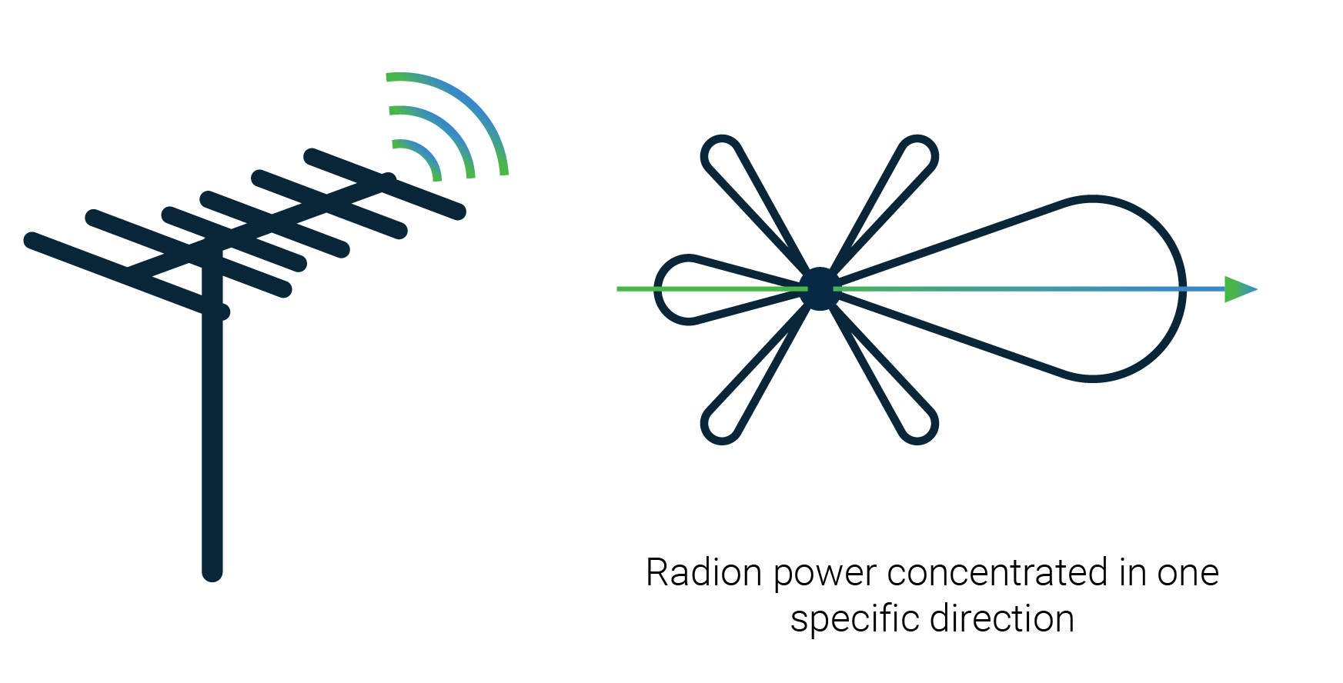
Directional Communication
Demand for high-speed data transfer
Wi-Fi and RF cannot keep up
Direction antennas provide:
High bit rate
High gain
Security
Minimizes packet collision
Spatial reuse enable higher bandwidth

Slide 3
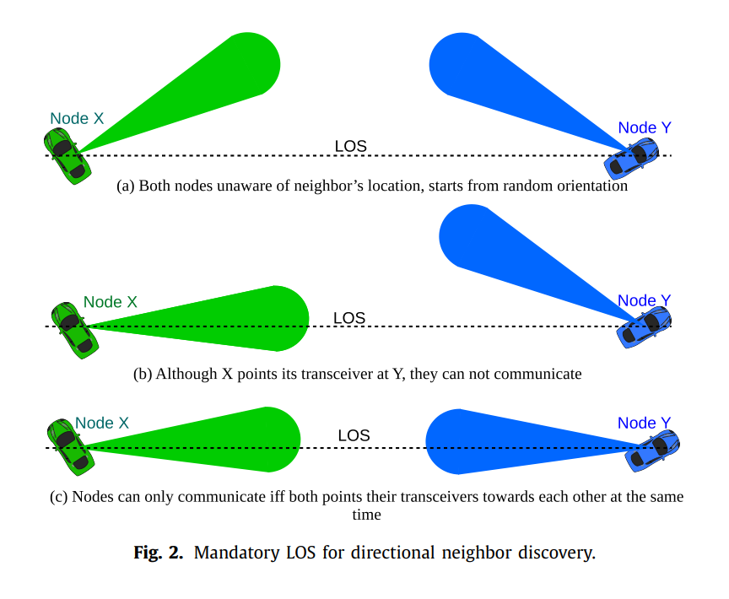
Electronically Steerable Optical Mesh
Directional antennas have limited coverage
Must be in line-of-sight (LOS) to communicate
Distributed coordination

Slide 4
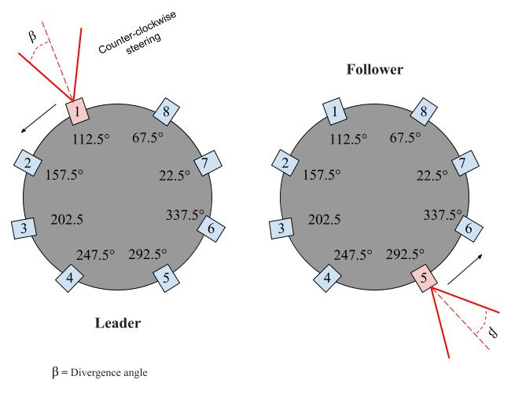
Model Assumptions
Nodes: each node exists in a 2D ad hoc network
Directional transceivers
Electronic beam steering: Activating a specific transceiver at a specific time, determines the direction of transmission/reception
Omni-assisted channel: LoRa is used to synchronize the LOS discovery
Compass
Number of transceivers
Transceiver angle
Multi-Hop communication
$$N_{tr}=⌈\frac{360}{2β}⌉$$
$$θ_{i}=\frac{i×360}{N_{tr}}+β$$

Slide 5
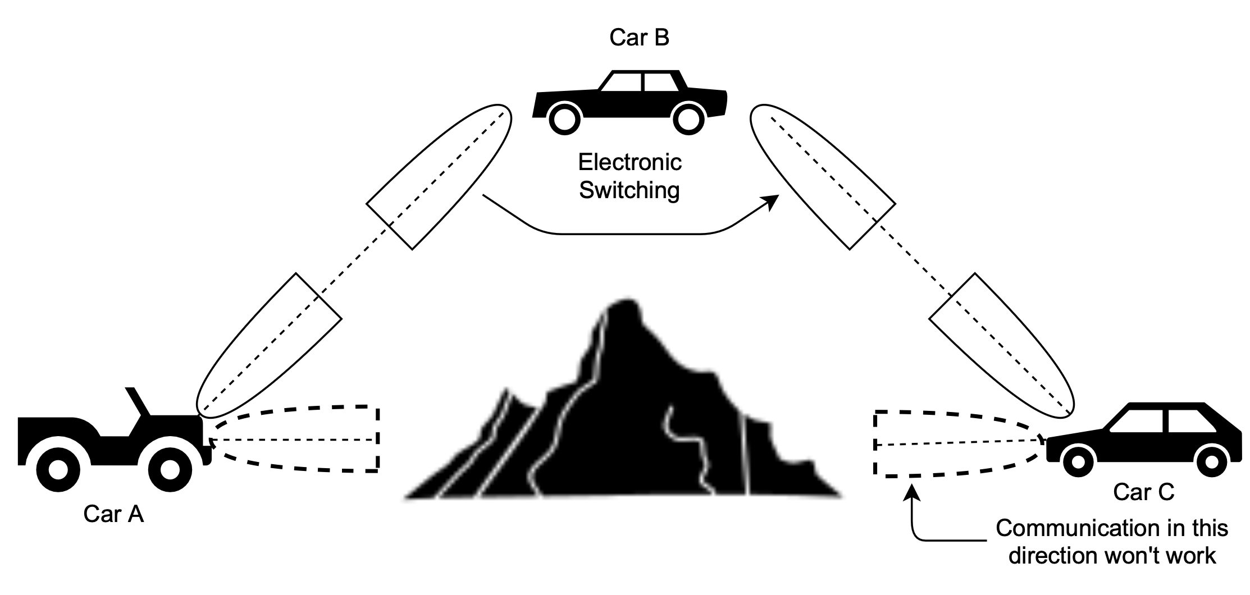
Goals
Mesh network that enables data transfer among multiple nodes.
Distributed coordination and communication
Per-packet beam scheduling
Enables communication via both single-hop and multi-hop FSO links

Slide 6
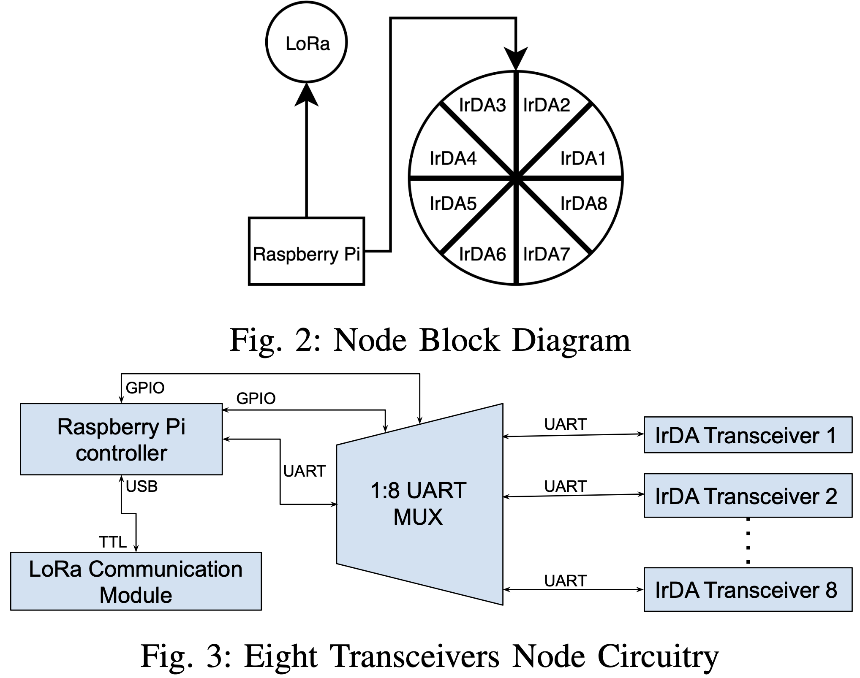

Slide 7
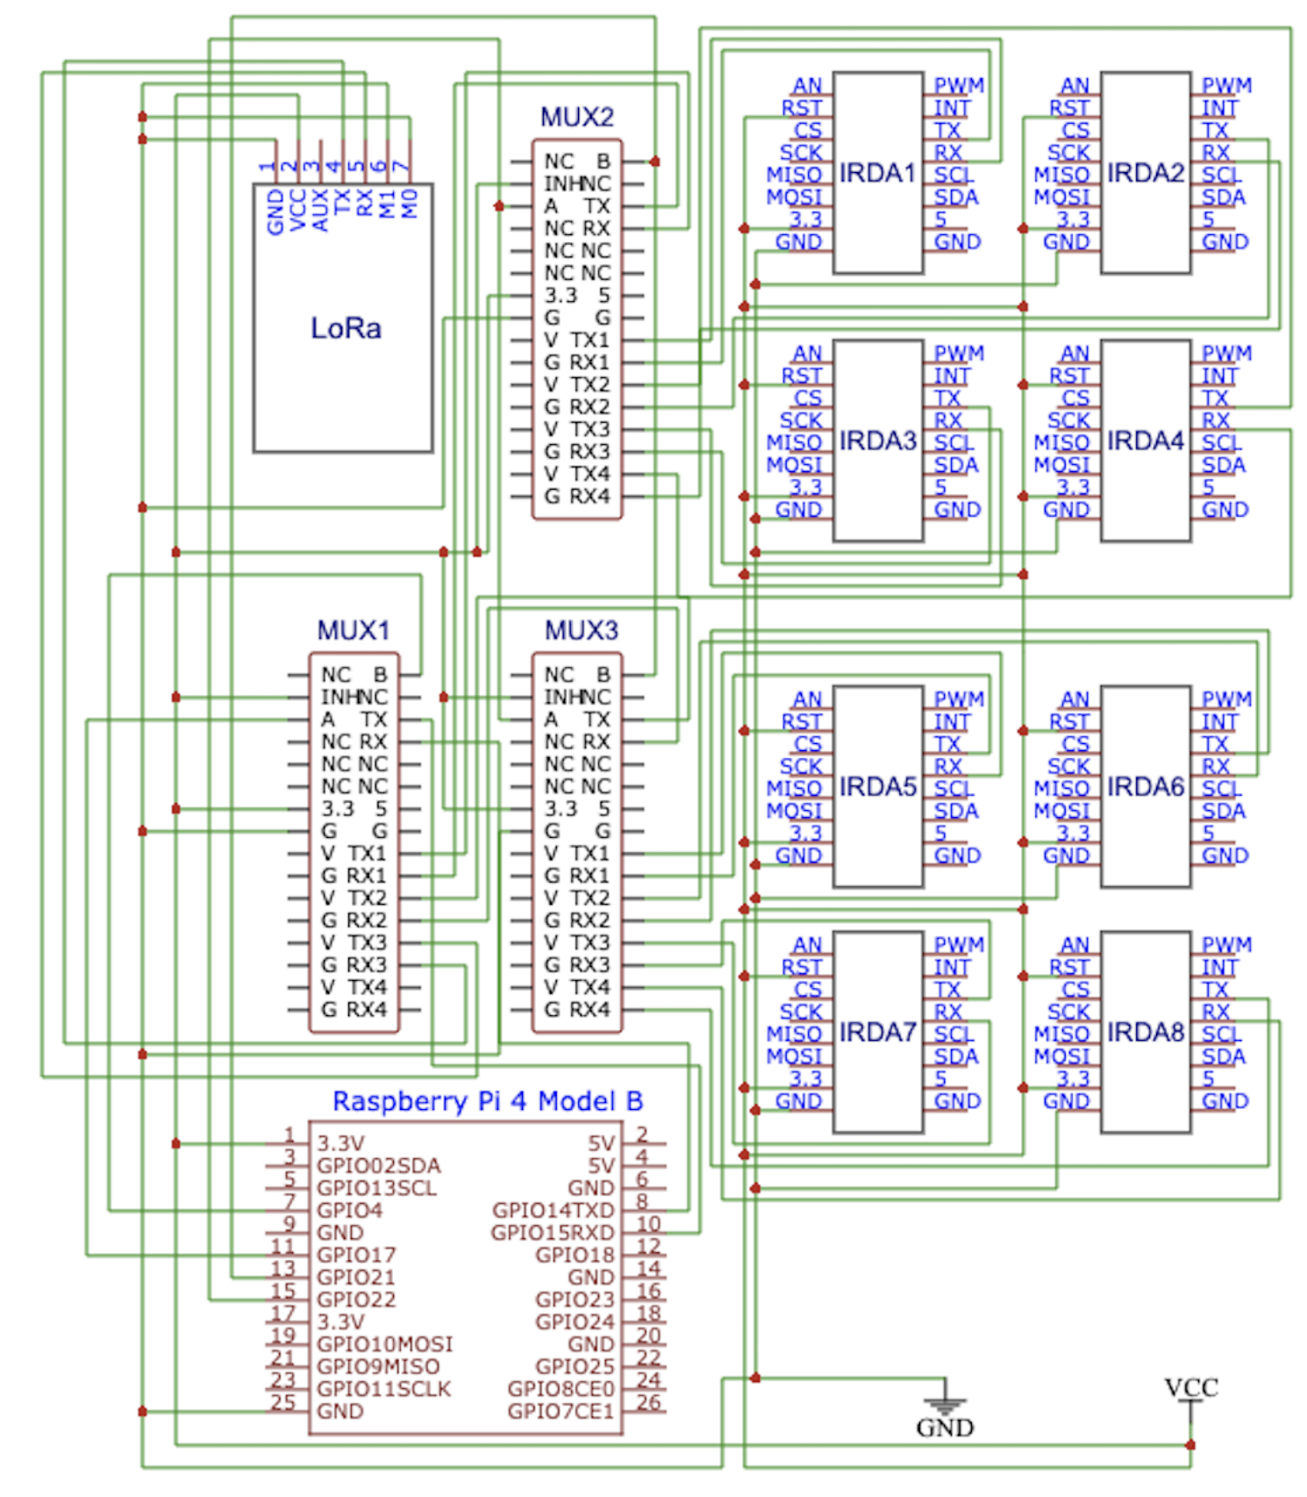

Slide 8
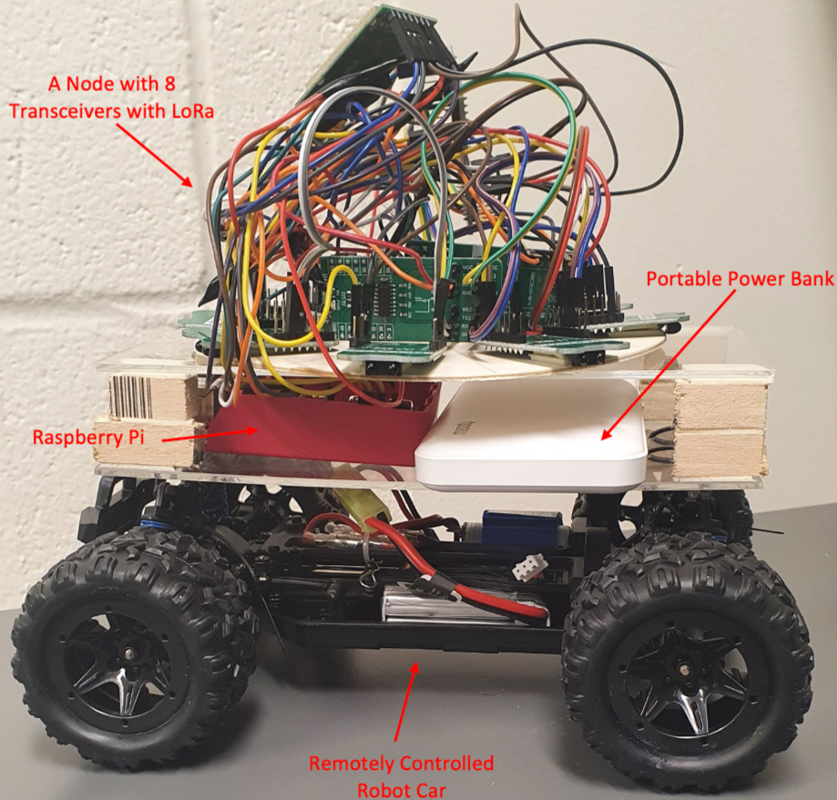
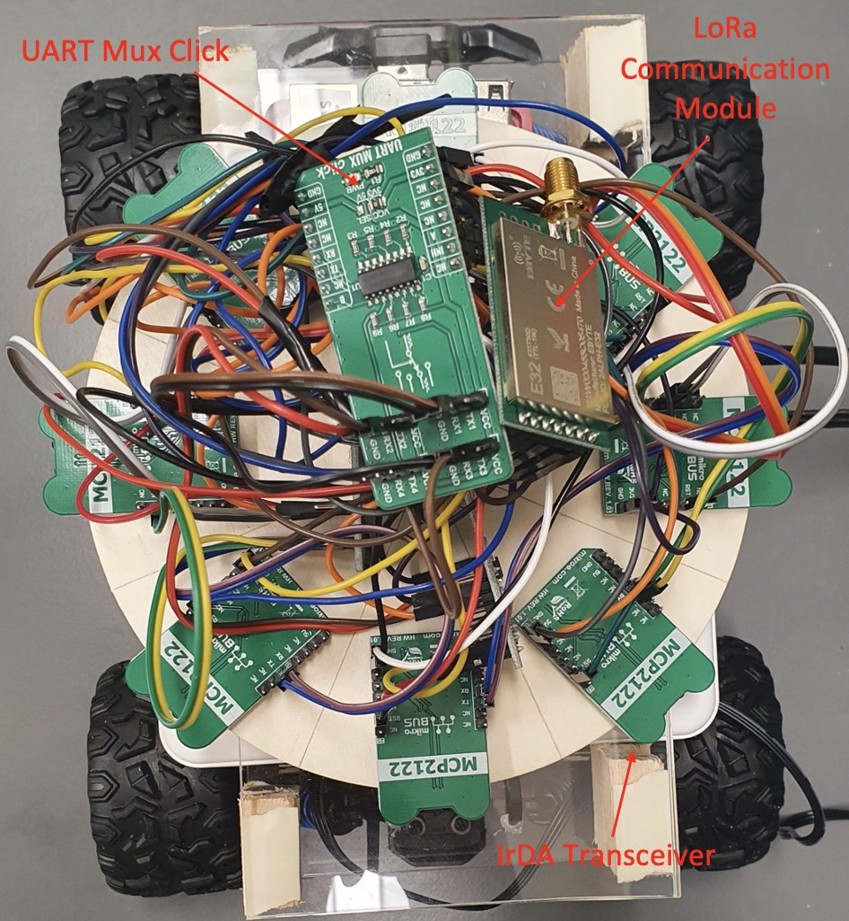
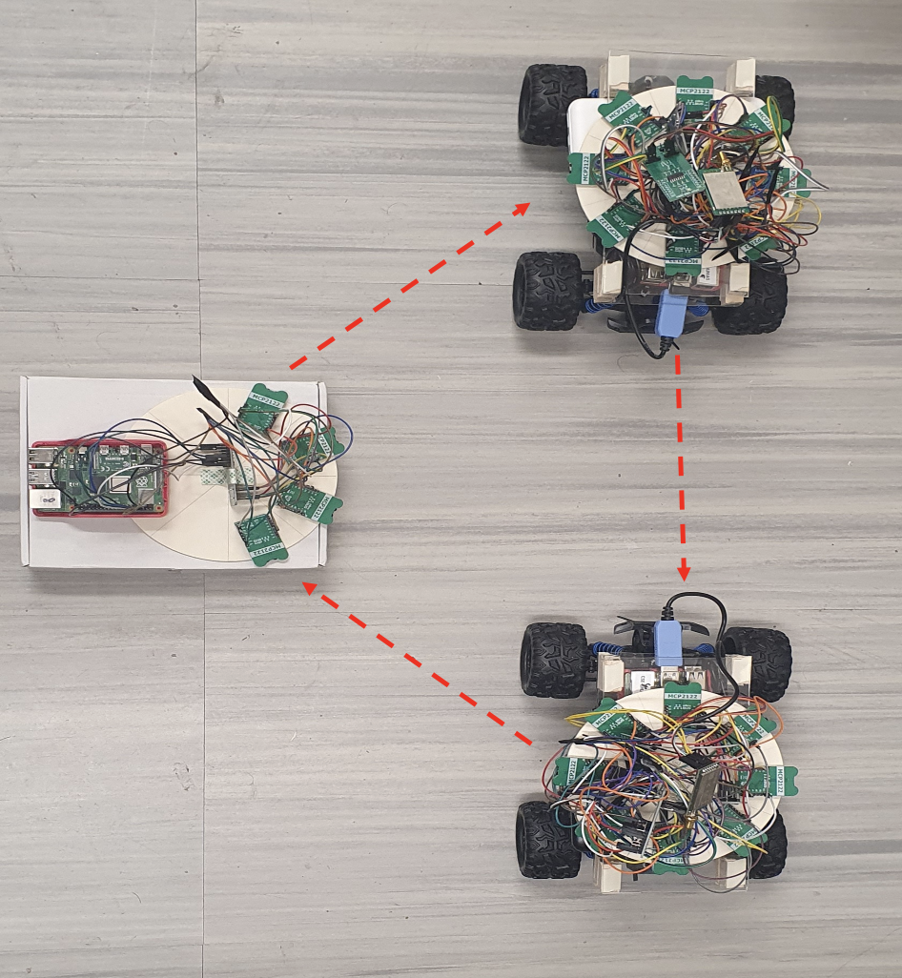
System Prototype using COTS devices

Slide 9
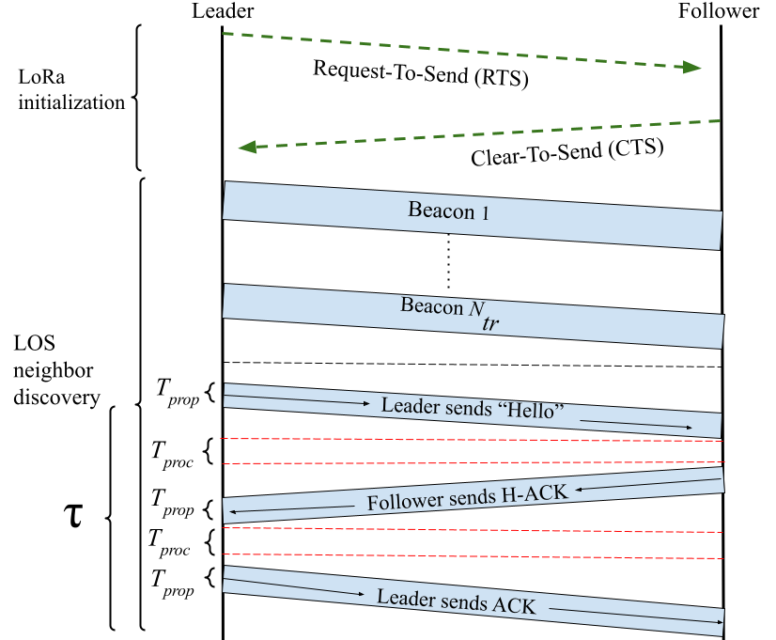
Omi-assisted Neighbor Discovery
Omni-assisted channel
Long Range omnidirectional channel(LoRa)
Can communicate with very low SNR
Discovery method guarantees neighbor discovery within one 360° beam sweep.

Slide 10
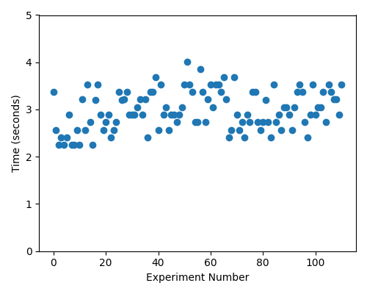
Neighbor Discovery Time
UART-based serial communication for sending packets through IRDA
Coded using Python
110 experiments
Sleep time: 160 milliseconds
Results in increase of 𝜏
Average time: 2.985 seconds

Slide 11
Distributed coordination for Data communication
Only one transceiver could be used for data communication
Need LoS transceiver selection
LoRA for coordination and FsO for data communication

Slide 12
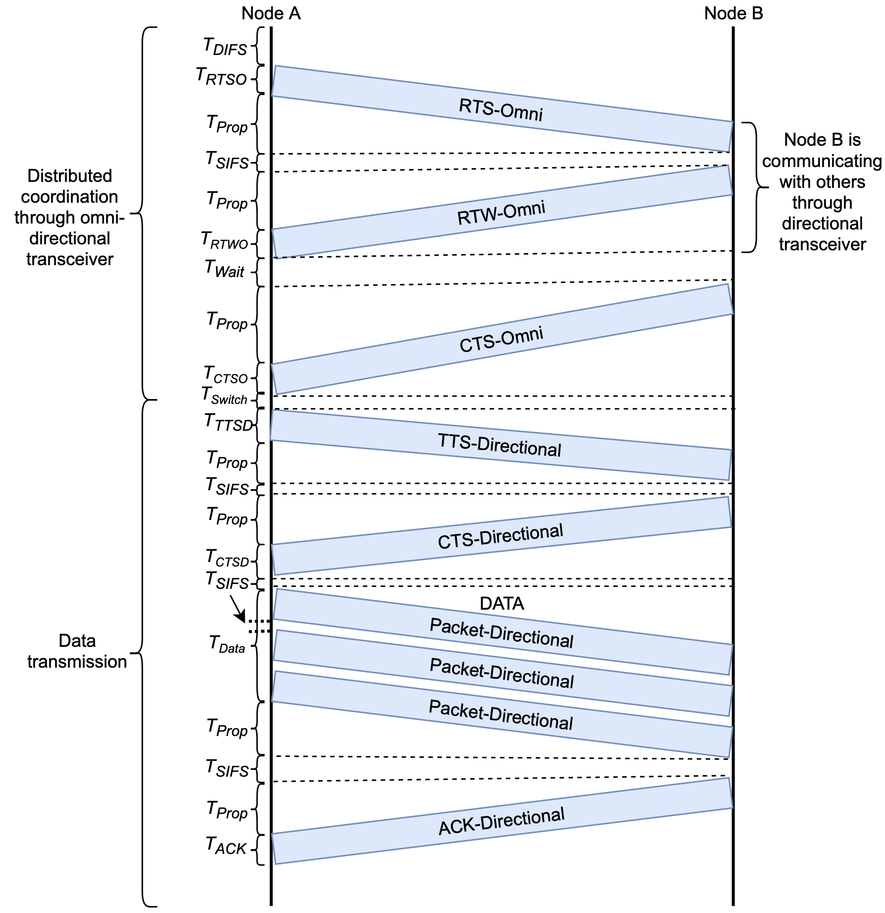
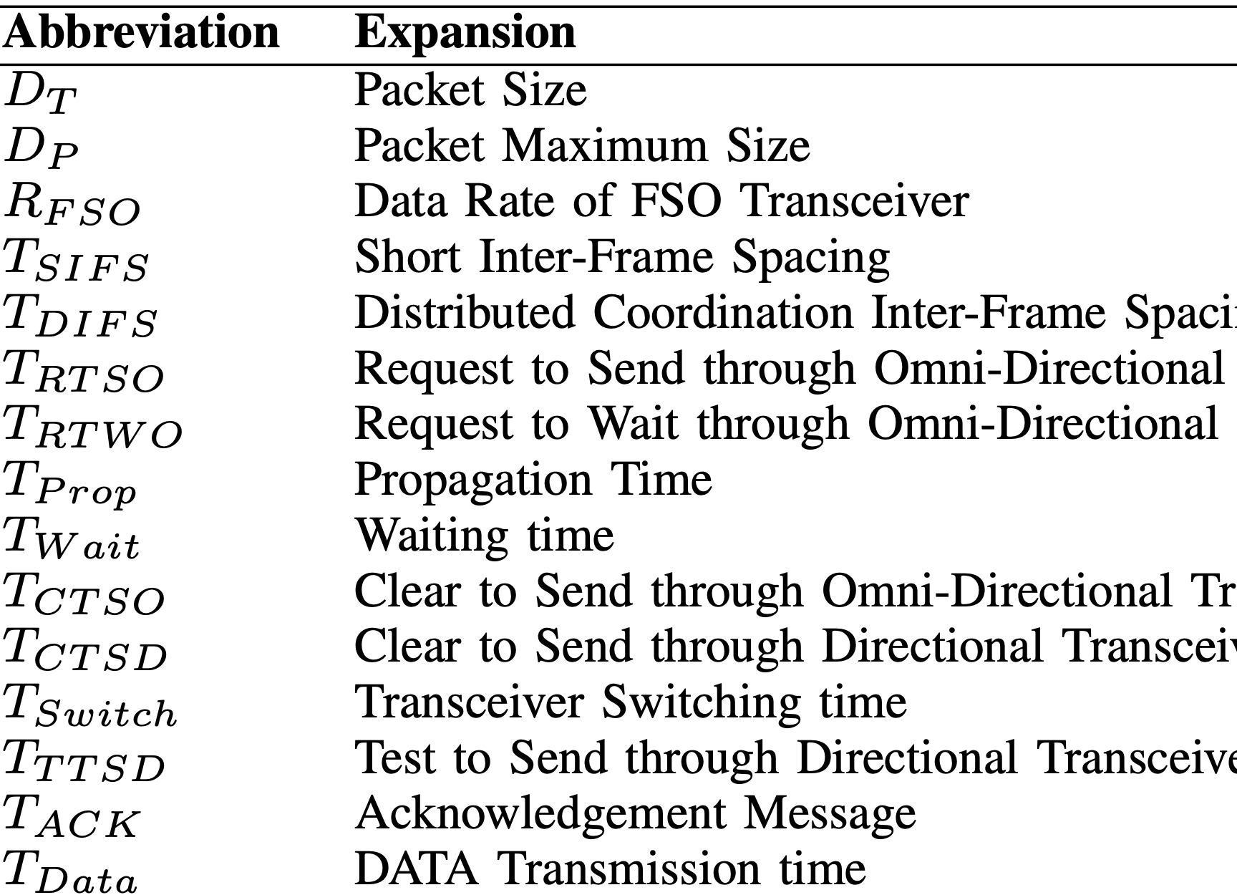
Handshake with Waiting

Slide 13
Experiment Results

Slide 14
Conclusion
Presents a design for a multi-hop wireless mesh network using directional communications
Each node is equipped with multiple directional transceivers for electronic beam-switching
Long-range low data rate omni channel for distributed coordination
Propose LoS discovery protocol
Propose waiting-based handshaking protocol for data communication
Validation on a state-of-the-art prototype using COTS

