Slide 1
Implementation of Interface Agility for Duplex Dynamic Spectrum Access Radio Using USRP
Suman Bhunia and Shamik Sengupta
Supported by NSF CAREER grant CNS #1346600

Slide 2
Outline
Introduction about DSA
Motivation of our work
Some Related Work
Proposed Model
Prototype
Performance Evaluation
Conclusion

Slide 3
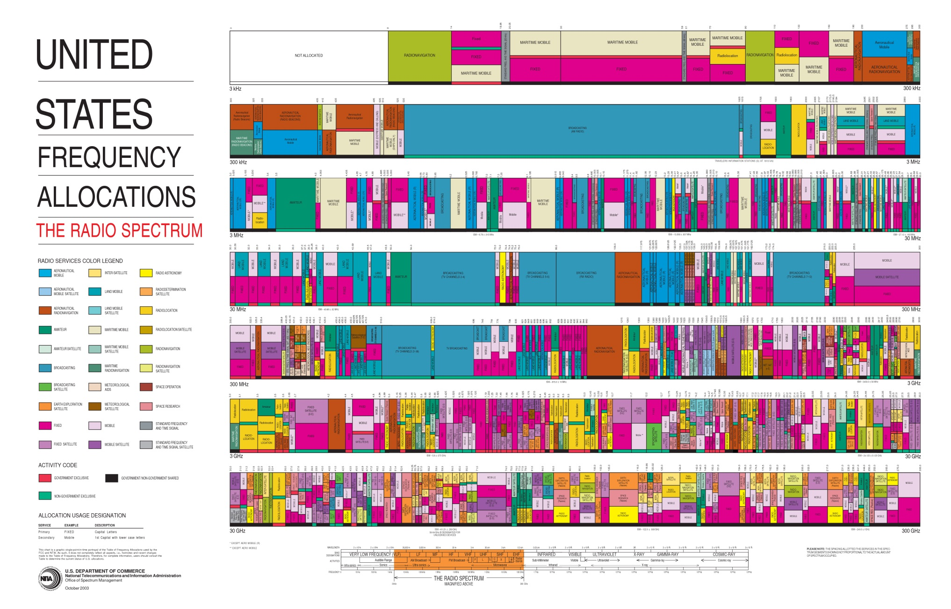
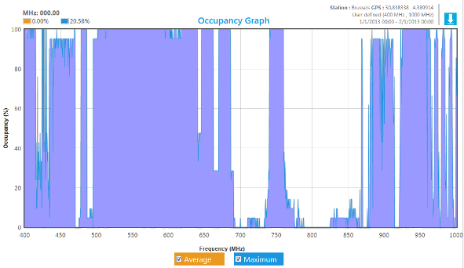
Why Dynamic Spectrum Access?

Slide 4
Heterogeneous channels in DSA
Dynamic RF environment
Dynamic spectrum requirement
Sometimes single spectrum opportunities are not adequate to support users’ requirements
Allocation of spectrum in the form of non-contiguous blocks
Adaptive bandwidth with spectrum demand
Sense for spectrum if PU arrives

Slide 5
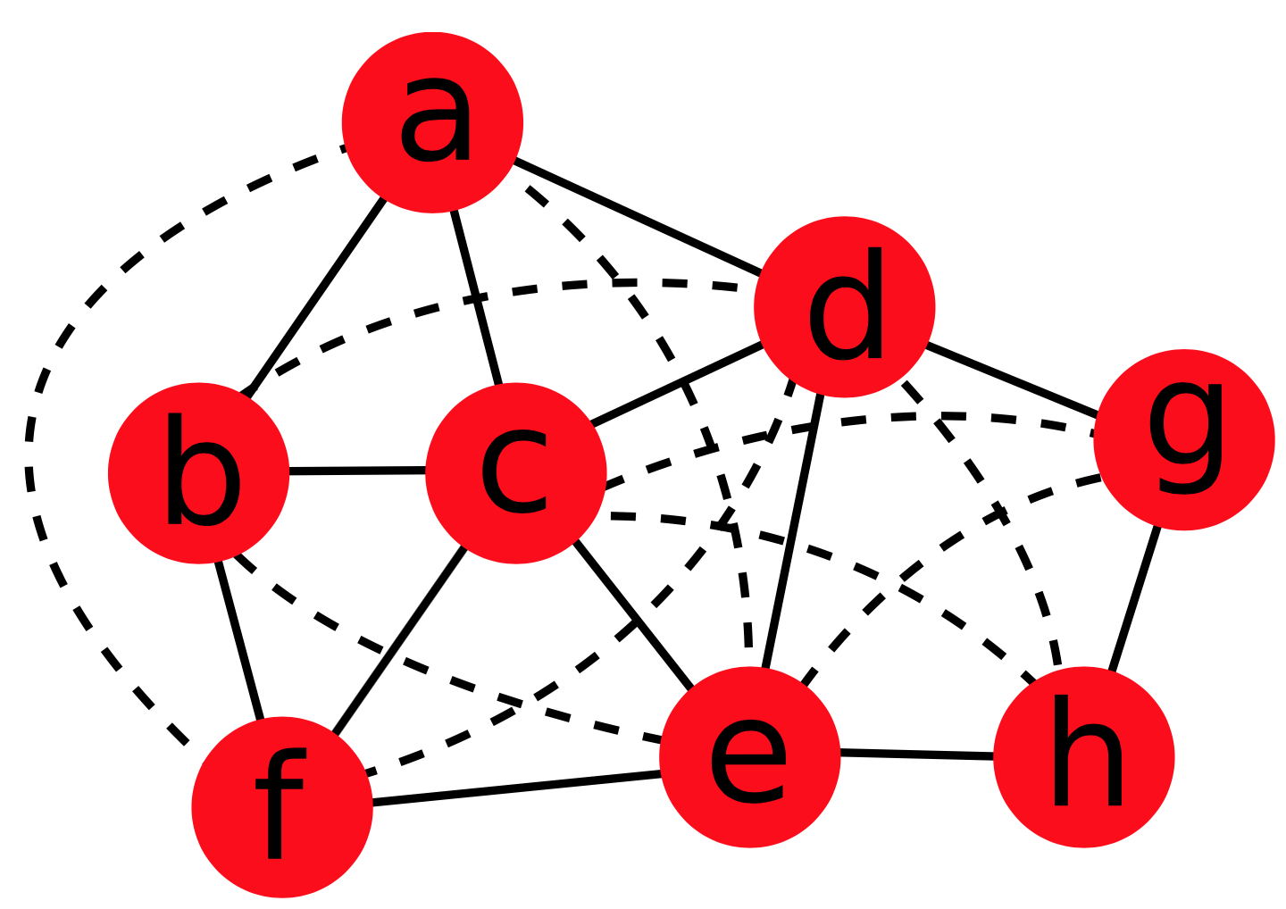
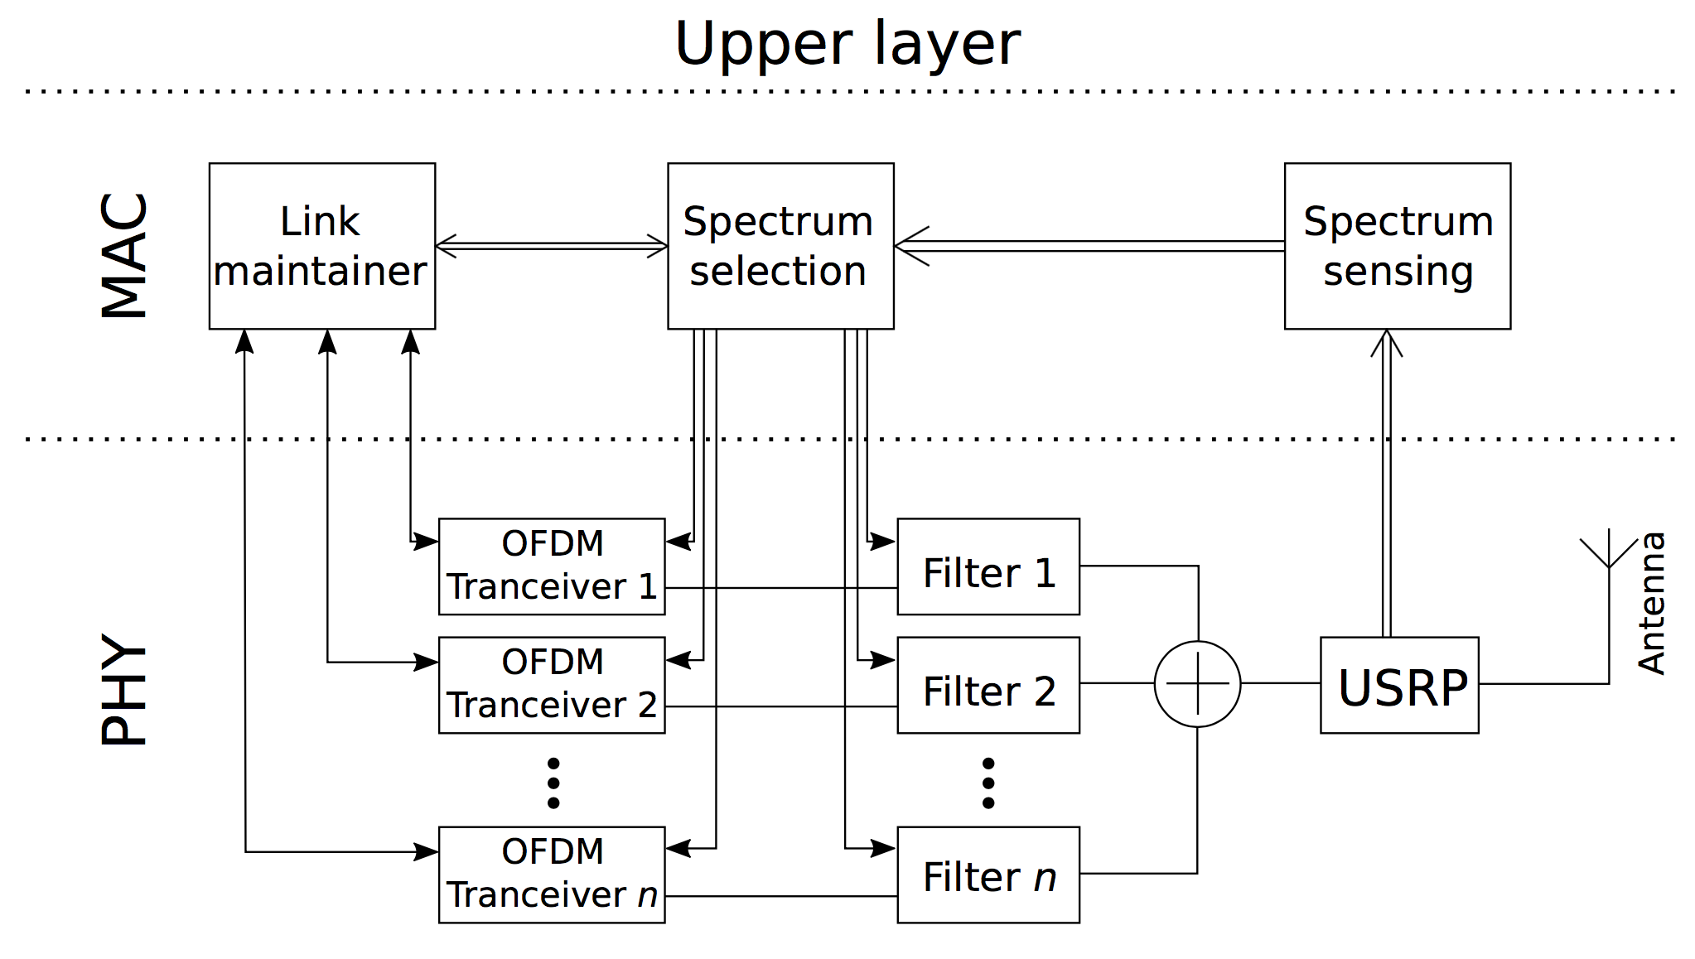
Dynamic heterogeneous virtual interface
splitting spectrum into fixed bandwidth channels or allocating spectrum in per packet basis is not an optimal solution
creating multiple heterogeneous virtual interfaces with a single radio interface
maintaining multiple independent simultaneous communications
transmission and reception simultaneously
dynamically adapting the number of virtual interfaces and parameters of the virtual interfaces when the data rate requirement in a flow changes or PU arrives
throughput of a mesh network can be enhanced up to 48%

Slide 6
Some related works
Aggregation Aware Spectrum Assignment (AASA) ¹
All users require the same amount of spectrum
Uses first-fit approach for channel assignments
Maximum Satisfactory Algorithm (MSA) ²
users may have different spectrum requirements
Uses best-fit algorithm
Channel Characteristic Aware Spectrum Aggregation algorithm (CCASA) ³
Considers the heterogeneity of data carrying capacity in spectrum
Uses sliding window method
D. Chen, Q. Zhang, and W. Jia, “Aggregation aware spectrum assignment in cognitive ad-hoc networks,” in 3rd International Conference on Cognitive Radio Oriented Wireless Networks and Communications, 2008. CrownCom 2008, pp. 1–6, IEEE, 2008.
F. Huang, W. Wang, H. Luo, G. Yu, and Z. Zhang, “Prediction based spectrum aggregation with hardware limitation in cognitive radio networks,” in IEEE 71st Vehicular Technology Conference (VTC 2010-Spring), 2010, pp. 1–5, IEEE, 2010.
J. Lin, L. Shen, N. Bao, B. Su, Z. Deng, and D. Wang, “Channel characteristic aware spectrum aggregation algorithm in cognitive radio networks,” in IEEE 36th Conference on Local Computer Networks (LCN), 2011, pp. 634–639, IEEE, 2011.

Slide 7
Related Works…
Jello: A MAC Overlay for Dynamic Spectrum Sharing¹
Distributed NC OFDM prototype
Distributed defragmentation triggered by other SU departure
Limited sensing window
Homogenous spectrum
L. Yang, W. Hou, L. Cao, B. Y. Zhao, and H. Zheng, “Supporting demanding wireless applications with frequency-agile radios.,” in Proceedings of the 7th USENIX Conference on Networked Systems Design and Implementation, NSDI 2010, pp. 65–80, 2010.

Slide 8
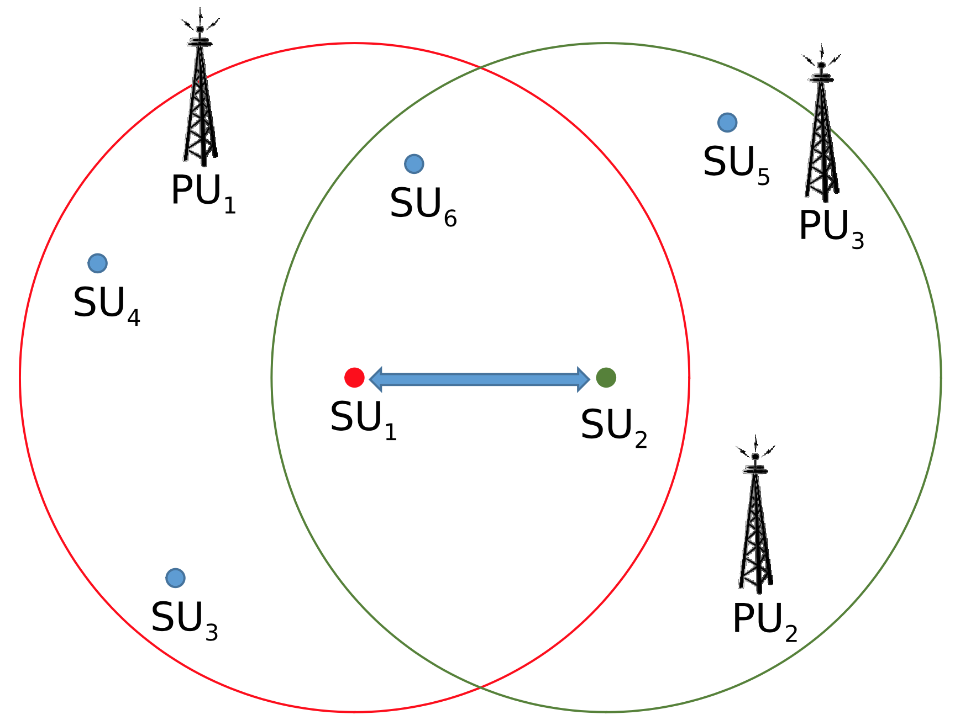
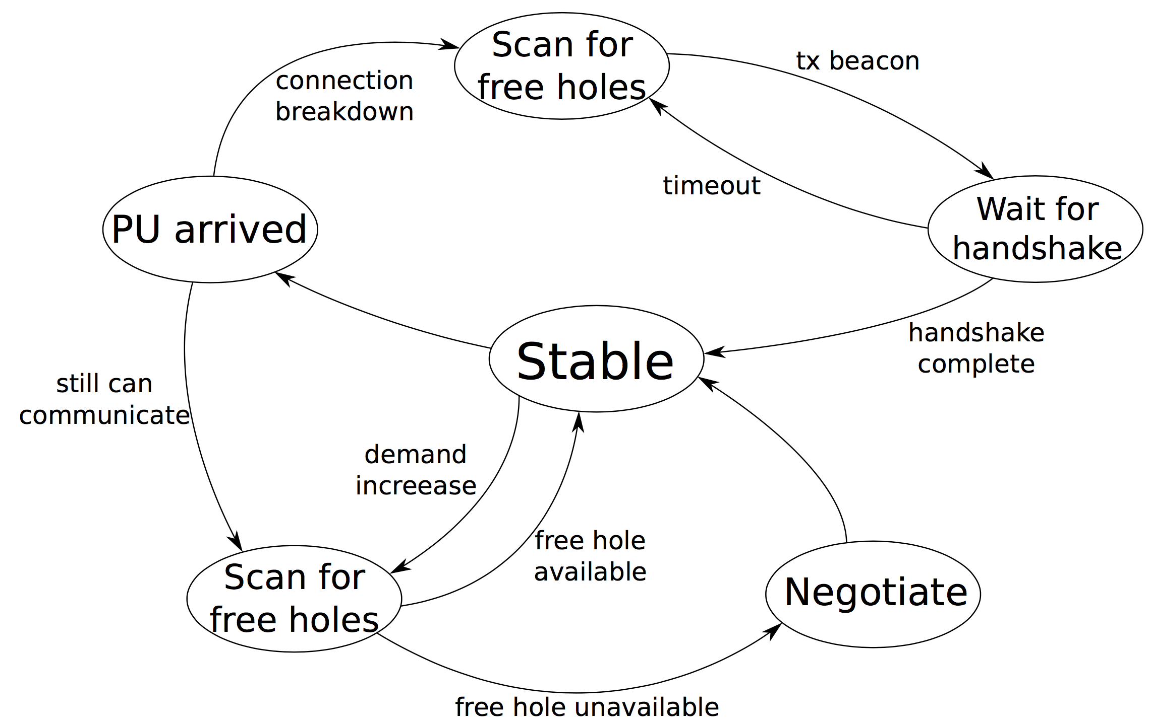
Proposed Methodology
System Considerations
Spectrum Fragmentation
Per session spectrum allocation
OFDM and guard bands
Heterogeneous channels
Full Duplex
Design challenges
Interference isolation
Carrier frequency noise
Preamble detection
Frequency offset in SDR

Slide 9
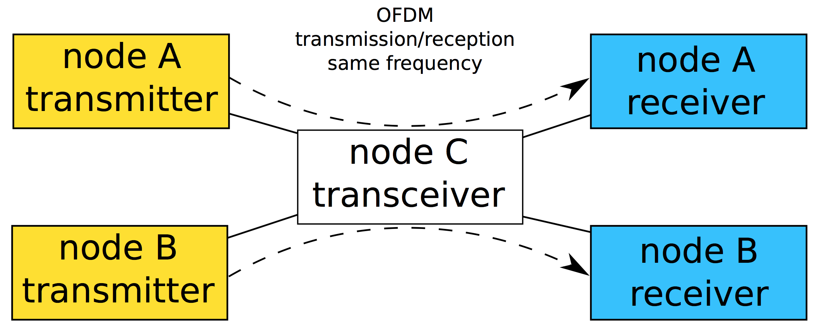
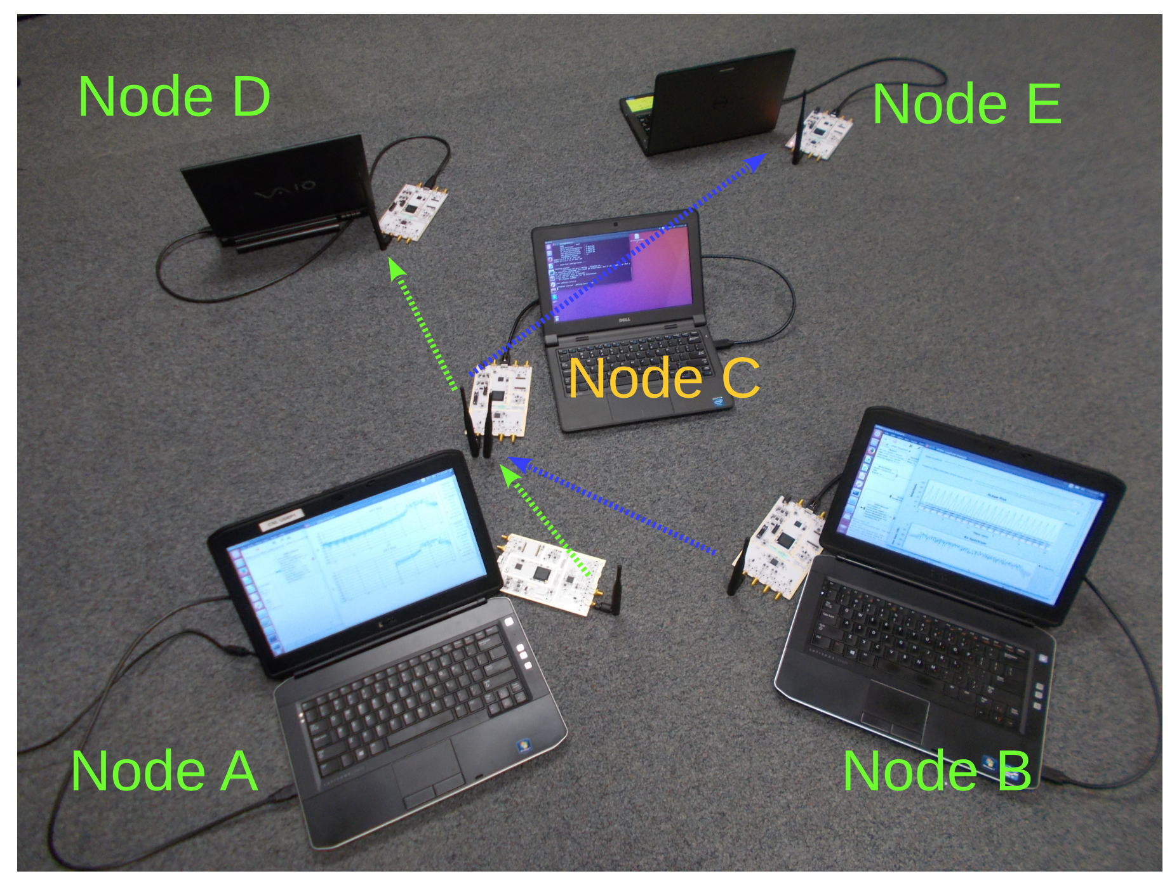
Prototype
USRP 200/210 SDR transceivers
Connected with laptops for DSP
GNURadio based
Running on Ubuntu 14.04
Channel’s central frequency is initially set to 2.442 GHz
3 types of nodes:
Transmitter / source
Receiver / sink
Transceiver / relay

Slide 10
Transmitter / source node design

Slide 11
Receiver / sink design

Slide 12
Transceiver / relay design

Slide 13
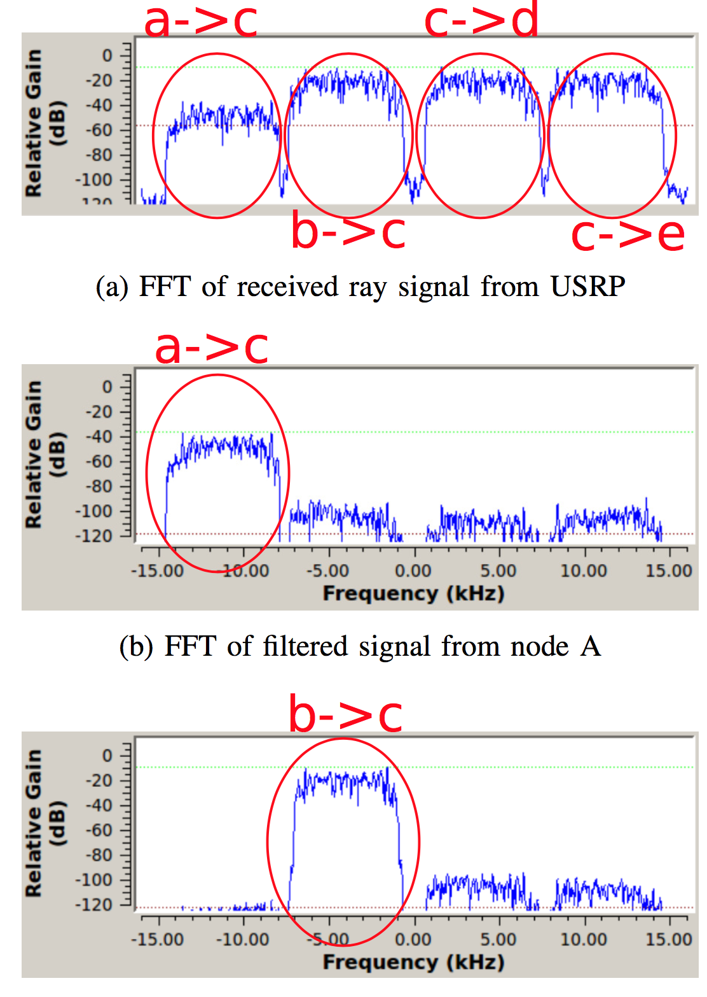
Signal flow
sd

Slide 14
Experiment with images
Original image and image with different spectrum availability

Slide 15
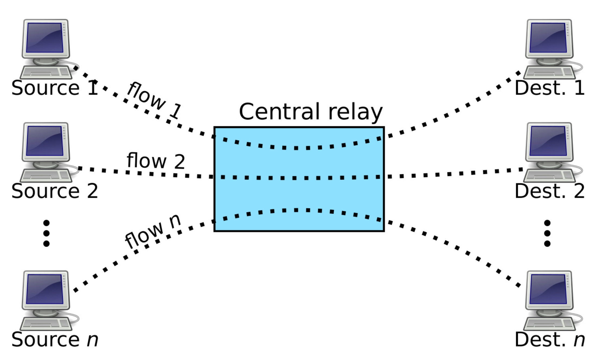
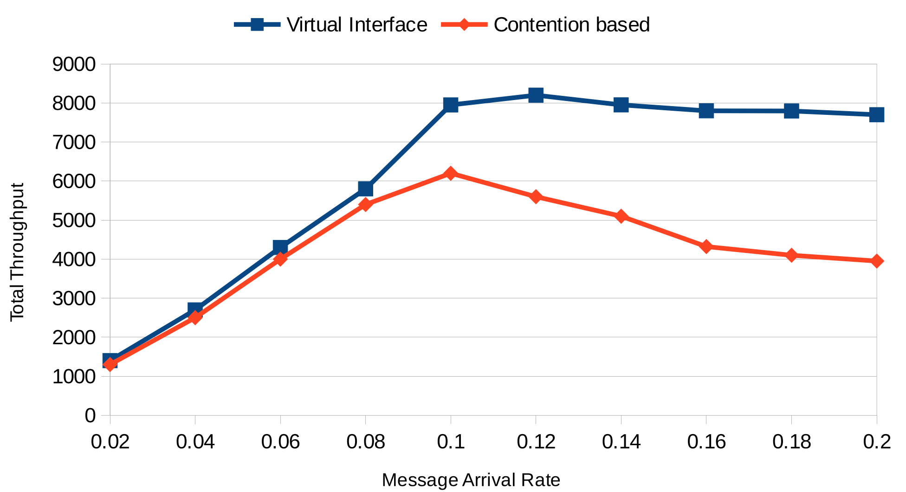
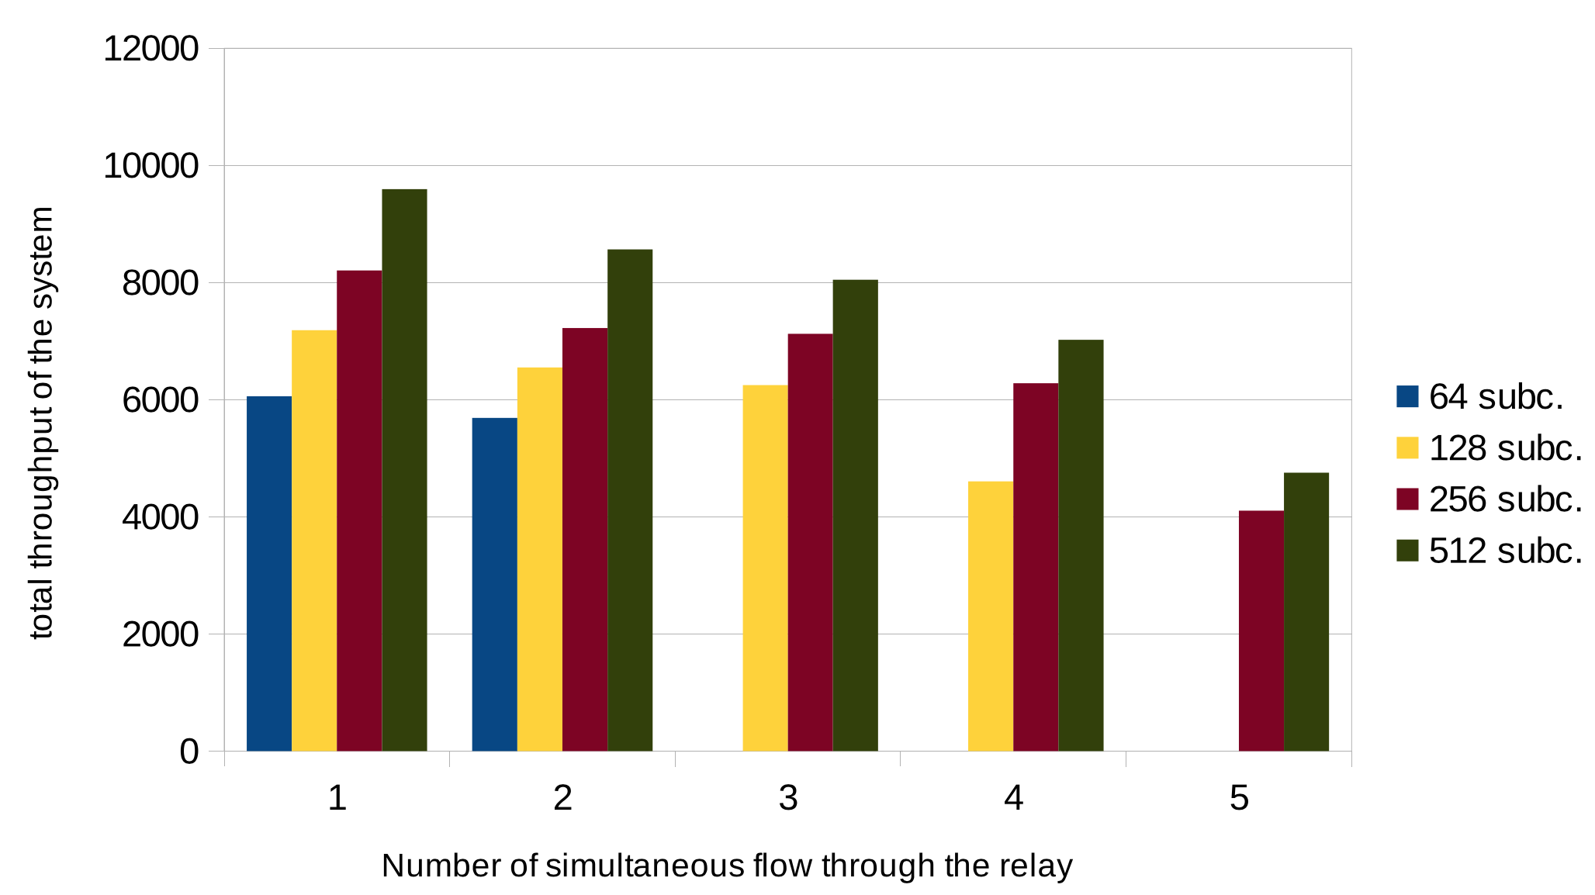
Experiment with multiple flow

Slide 16
Conclusion
In this paper, we presented a model for dynamic spectrum access in multi-hop networks
Developed with off-the-shelf SDR
Show the usability of adaptive radio interface
Communication with multiple neighbors simultaneously
A gossip-based framework is proposed to negotiate spectrum
The system can achieve up to 48% enhancement for throughput

Slide 17
Thank You!

