Slide 1
With ChatGPT, do we have to rewrite our learning objectives - CASE study in Cybersecurity
Peter Jamieson, Suman Bhunia, Dhananjai M. Rao
Miami University, Ohio

Slide 2
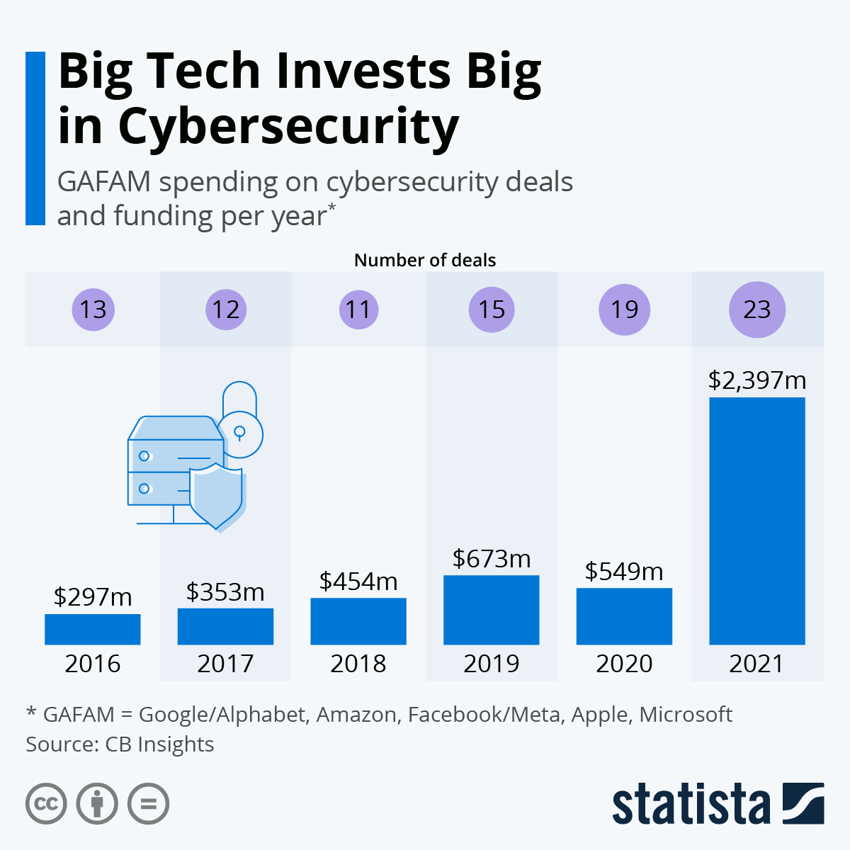
Accelerated growth of Cybersecurity & AI
Estimated growth is $32.97 Billion.
The banking, financial services, and insurance market is integrating AI into their workflows. The adoption of AI is education is also rapidly growing.

Slide 3
Accelerated growth of Cybersecurity & AI
Can we combine the two areas for ”high impact” educational experiences for students?
Estimated growth is $32.97 Billion.
The banking, financial services, and insurance market is integrating AI into their workflows. The adoption of AI is education is also rapidly growing.

Slide 4
A new cybersecurity major at Miami
We have a new BS in Cybersecurity program offered by the CSE department at Miami University!
Please help spread the word about our new program!
https://programs.miamioh.edu/program/cybersecurity-b-s/

Slide 5
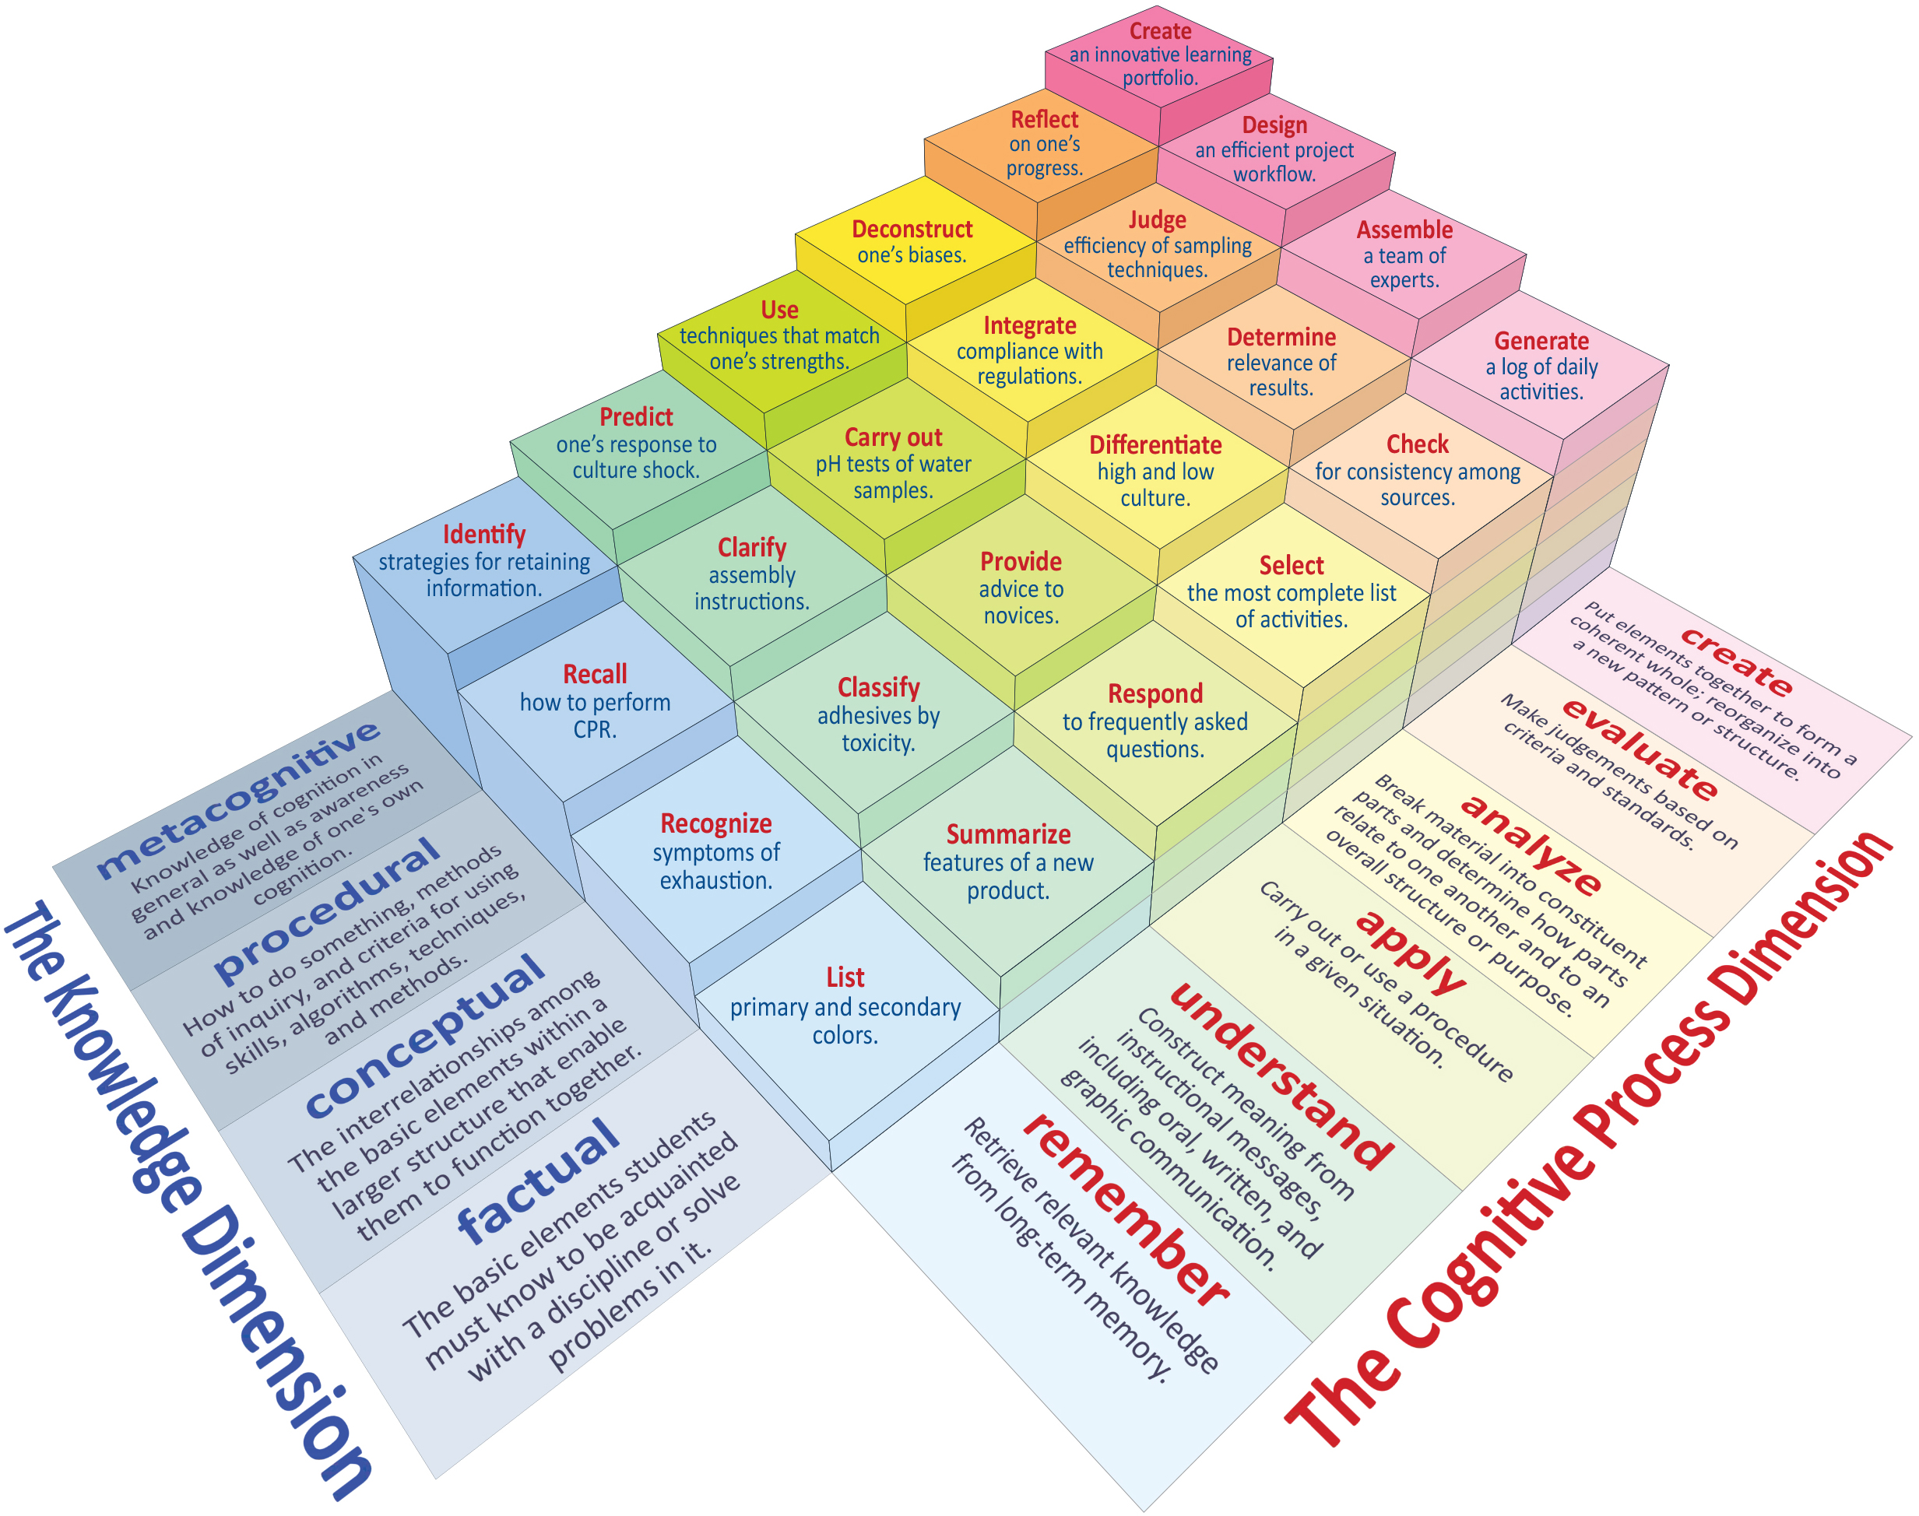
The two dimensions of Bloom’s taxonomy
In study we used Bloom’s taxonomy as our reference

Slide 6
The two dimensions of Bloom’s taxonomy
In study we used Bloom’s taxonomy as our reference
We reviewed Learning Outcomes (LOs) from our new Cybersecurity major
We focused on analyzing if the cognitive or knowledge dimension for each LO could be increased

Slide 7
Example of Courses and Outcomes
Course Number | Course Name
CYB134 | Introduction to Cybersecurity
CYB234 | Sysadmin & scripting
CYB235 | Computer networks
CYB236 | Data Security
CYB331 | Software Security
CYB332 | Organizational and Human Security
CYB334 | Network security
CYB335 | Defensive Security
CYB435 | Offensive Security
Knowledge Areas | Knowledge Units | Course coverage
 |  | Course | LO level
Data Security | Cryptography | CYB 236 | Apply
 | Digital Forensics | CYB 236 | Remember
 | Data Integrity and Authentication | CYB 334 | Apply
 |  | CYB 236 | Analyze
 | Access Control | CYB 334 | Apply
 |  | CYB 236 | Understand
 | Secure Communication Protocols | CYB 334 | Analyze
 | Cryptanalysis | CYB 236 | Understand
 | Data Privacy | CYB 236 | Understand
 | Information Storage Security | CYB 236 | Understand
Full table of LOs is in our paper

Slide 8
Example of Courses and Outcomes
Course Number | Course Name
CYB134 | Introduction to Cybersecurity
CYB234 | Sysadmin & scripting
CYB235 | Computer networks
CYB236 | Data Security
CYB331 | Software Security
CYB332 | Organizational and Human Security
CYB334 | Network security
CYB335 | Defensive Security
CYB435 | Offensive Security
Knowledge Areas | Knowledge Units | Course coverage
 |  | Course | LO level
Software Security | Fundamental Principles | CYB 331 | Understand
 | Design | CYB 331 | Understand
 | Implementation | CYB 331 | Apply
 | Analysis and Testing | CYB 331 | Apply
 | Deployment and Maintenance | CYB 331 | Understand
 | Documentation | CYB 331 | Understand
 | Ethics | CYB 331 | Understand
Full table of LOs is in our paper

Slide 9
Example of Courses and Outcomes
Course Number | Course Name
CYB134 | Introduction to Cybersecurity
CYB234 | Sysadmin & scripting
CYB235 | Computer networks
CYB236 | Data Security
CYB331 | Software Security
CYB332 | Organizational and Human Security
CYB334 | Network security
CYB335 | Defensive Security
CYB435 | Offensive Security
Knowledge Areas | Knowledge Units | Course coverage
 |  | Course | LO level
Connection Security | Physical Media | CYB 235 | Remember
 | Physical Interfaces and Connectors | CYB 235 | Remember
 | Hardware Architecture | CYB 235 | Remember
 | Distributed Systems Architecture | CYB 235 | Remember
 | Network Architecture | CYB 235 | Analyze
 | Network Implementations | CYB 235 | Apply
 | Network Services | CYB 235 | Remember
Full table of LOs is in our paper

Slide 10
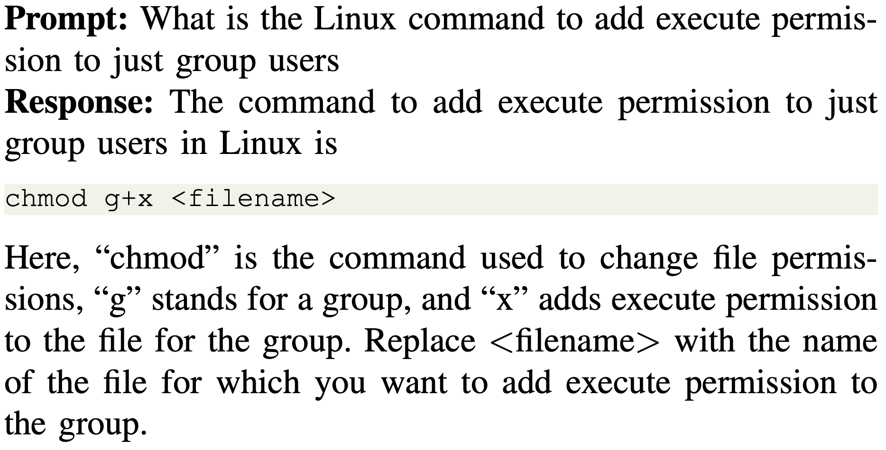
Case study #1: Data Security – Access Control
LO: “Identify and explain the importance of basic system administration tasks” in the course CYB 234 (Sysadmin & scripting)

Slide 11
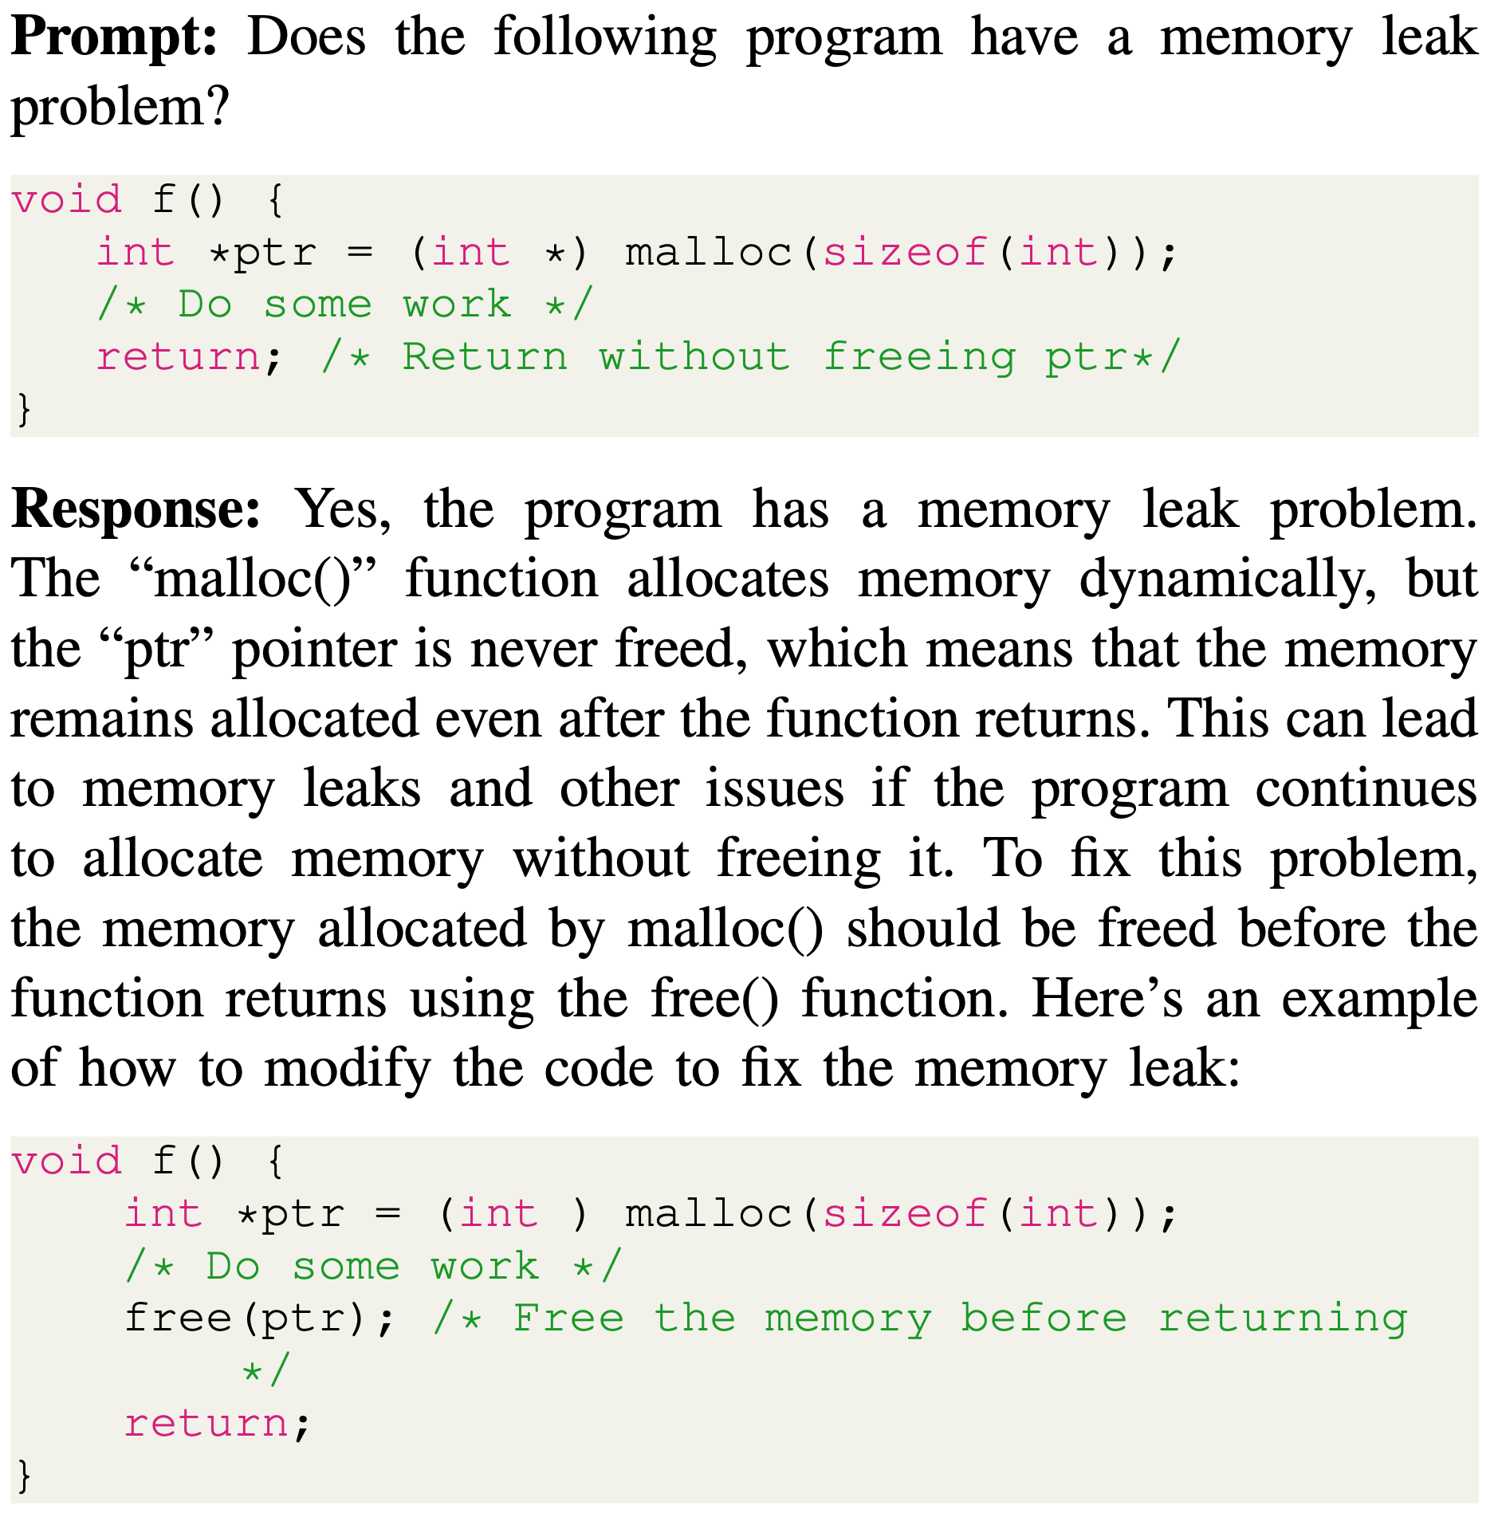
Case study #2: Software Security- Analysis and Testing
LO: “Describe and apply static and dynamic software testing methods” in CYB 331 - Software Security.

Slide 12
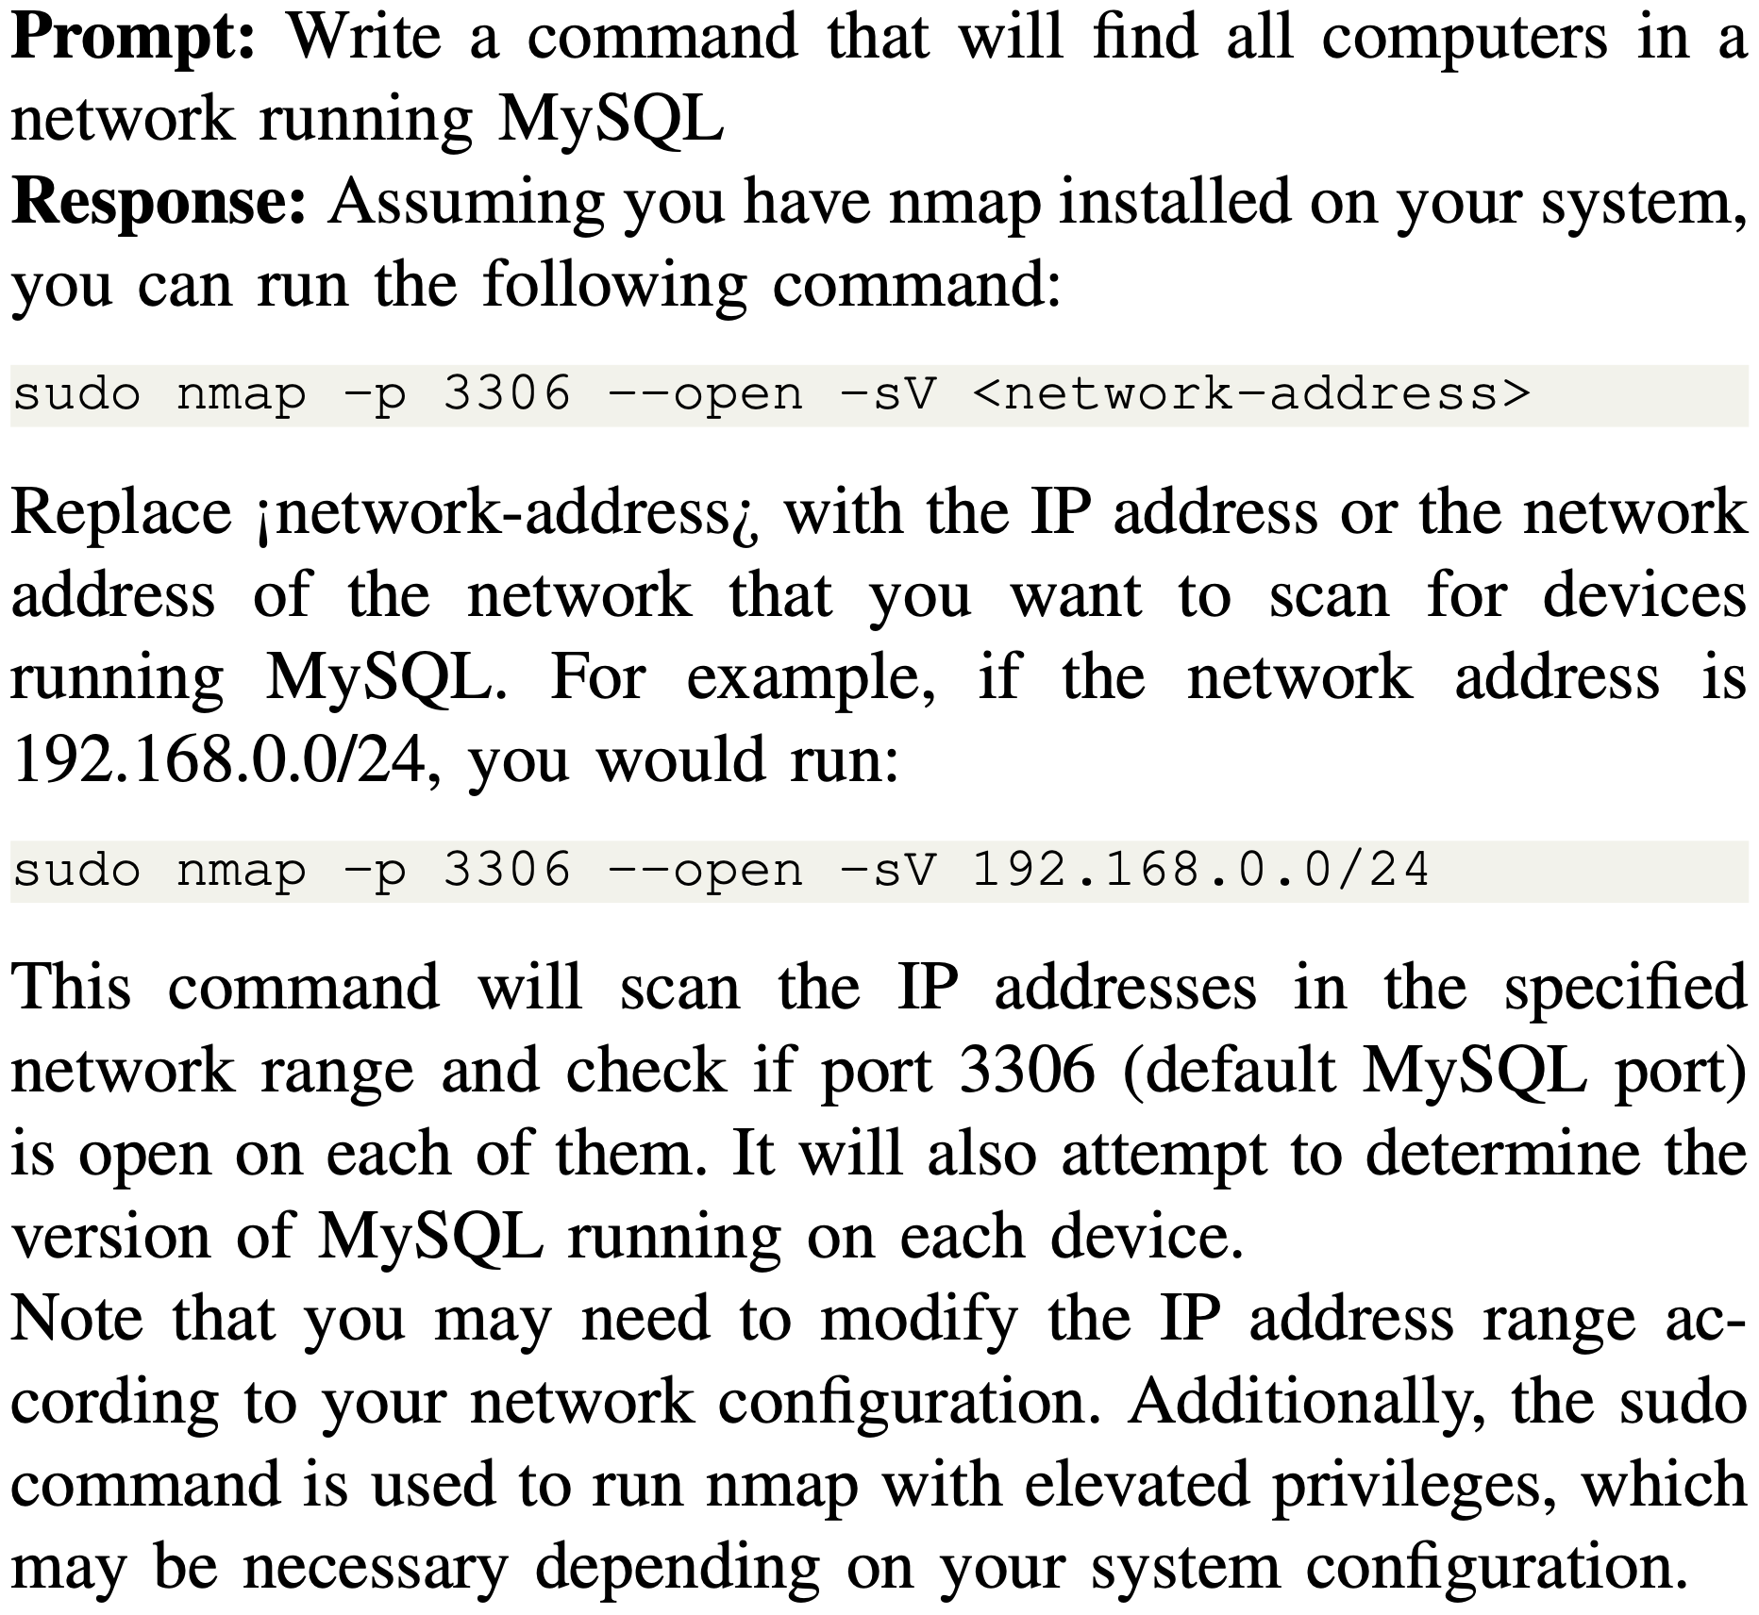
Case study #3 Connection Security - Distributed System Architecture
LO: “Describe application layer security protocols” in CYB 334 (Network security)

Slide 13
Conclusions
The study focuses on proposing potential impacts of Large Language Models (LLMs) (like ChatGPT) on the learning outcomes (LOs) of a cybersecurity curriculum.
Bloom's taxonomy and LOs were used as a framework to assess the existing cybersecurity curriculum.
The analysis revealed that many LOs in cybersecurity fall under "low-order" thinking skills.
The hypothesis suggests that ChatGPT's capabilities could accelerate some of the existing LOs in cybersecurity.
We presented five examples demonstrating how ChatGPT can enhance existing LOs.
Two key findings emerged from the study:
ChatGPT can help learners quickly generate content, but learners need guidance on creating prompts, validating responses, and understanding the vocabulary for effective use.
The study highlights the need to teach concepts that require "first-principle" learning approaches and motivate students to perform basic exercises that ChatGPT can easily handle.
Future work: We propose to assess the use of AI to teach selected cybersecurity concepts for deeper exploration.

